Slide 1








BRICS CoP October Seminar
Evolving BRICS Ecosystem
AI Integration with Query Tool
BRICS Data Analysis Using “R” Programming
Biomedical Research Informatics Computing System (BRICS)
October 7th, 2026

Slide 2
Logistics
Audio/Video | Please keep your microphone muted
Recording | Today’s session will be recorded Will be posted on the BRICS website: https://brics.cit.nih.gov/demo
Questions & Comments | We encourage your participation today Please use the chat for questions & comments. The chat will be monitored throughout today’s demo. There will also be time after each speaker and at the end of the demo to ask live questions.

Slide 3
Agenda
Time | Topic | Speaker(s)
9:00 AM-9:05 AM | Opening Remarks | Dr. Matthew McAuliffe
9:05 AM-9:10 AM | Evolving BRICS Ecosystem | Evan McCreedy
9:10 AM-9:30 AM | AI Integration with Query Tool | Dr. Matthew McAuliffe
9:30 AM – 9:55 AM | BRICS Data Analysis Using “R” Programming | Dr. Dominic Nathan
9:55 AM-10:00 AM | Closing Remarks | Dr. Matthew McAuliffe

Slide 4

Biomedical Research Informatics Computing System (BRICS)
Evolving BRICS Ecosystem
Evan McCreedy

Slide 5




NICHD DASH Built from BRICS
  NICHD DASH (Data and Specimen Hub) is the NICHD (National Institute of Child Health and Development) designated repository for researchers to share de-identified data from clinical and population health studies relevant to NICHD populations
  NICHD DASH is a new instance built from the BRICS framework launching soon
~300
66
873
168
10
16
STUDIES
STUDY TOPICS
DATA
REQUESTS
DATA USE
PUBLICATIONS
STUDIES
OFFERING
BIOSPECIMENS
BIOSPECIMENS
REQUESTS
https://dash.nichd.nih.gov

Slide 6

BioCoRE | Biomedical Collaborative Research Environment
A multi-tenant, cloud-hosted enterprise research informatics platform designed to meet NIH controlled-access data repository compliance
Notes:
Option 1

Slide 7
Introduction to BioCoRE
Security & Compliance
Extends the BRICS framework with a multi-tenant Authority to Operate, and controls designed to meet current Controlled Access Data Repository requirements
Integration w/ NIH Workspaces
Enables researchers to collaborate and analyze data in the cloud without downloading sensitive information to local environments
Multi-tenant Architecture
Multiple research programs can operate within one platform while maintaining appropriate separation, access controls, and program-specific governance
Scalable Cloud Deployment
NIH STRIDES on AWS provides scalable infrastructure that can expand as additional datasets are added

Slide 8
AI Integration with Query Tool
Dr. Matthew McAuliffe

Slide 9


Query Tool AI Integration
AI takes user query and searches study metadata,
returns results
QT data pulled
User enters natural language query
studies
User confirms data selection
AI process
form structures
User adjusts search

Slide 10

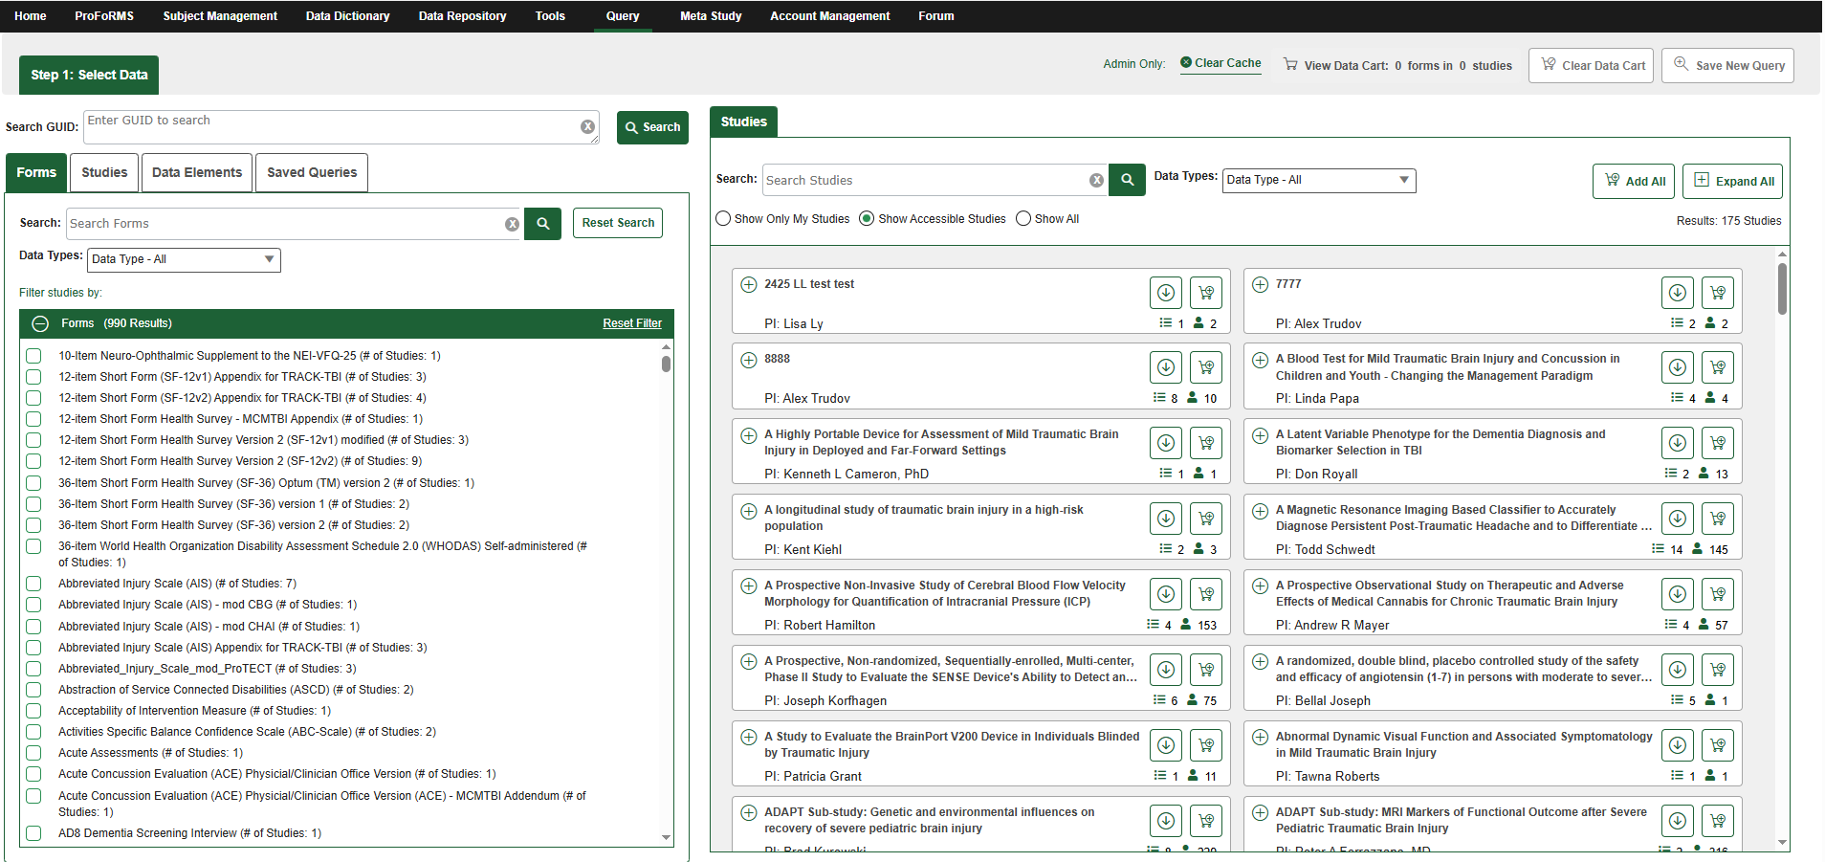

Productionizing the AI process
Query Tool AI Integration
QT UI
(User Browser)
(Existing) Java layer to handle data & authenticate
(New) Python backend (container on-prem)
AWS
Bedrock
Postgres (vector DB)
Metadata updates to form structures and studies are collected
Java process to update embeddings

Slide 11
Demo
Notes:
Tech Stack
AI backend language: Python
AI framework: LangChain & LangGraph
Vector DB: PostgreSQL using pgVector Extension
Model inference: AWS Bedrock
LLM family: Anthropic Claude Haiku 4.5
us.anthropic.claude-haiku-4-5-20251001-v1:0
Embedding model: Amazon Titan
amazon.titan-embed-text-v2:0
POC UI: Query Tool

Slide 12

Questions?

Slide 13
The NIH Biomedical Research Informatic Computing System (BRICS): a unified platform supporting the full lifecycle of clinical trials research
BRICS Data Analysis Using “R” Programming
Dominic E. Nathan, PhD
7th October 2026

Slide 14
Disclaimer
“The presenter has no conflicts of interest to disclose. The views, information or content, and conclusions presented do not necessarily represent the official position or policy of, nor should any official endorsement be inferred on the part of, the Uniformed Services University, the Department of Defense, the U.S. Government, Department of Health and Human Services, National Institutes of Health, US Public Health Service Commissioned Corps.”

Slide 15
Analytics with BRICS: Scaling
Cloud Computing
Scale up
Personal Computer

Slide 16
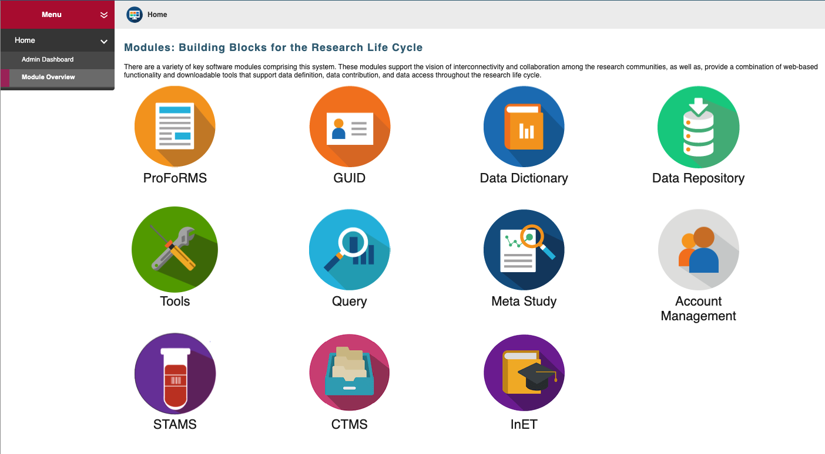
BRICS Modules

Slide 17
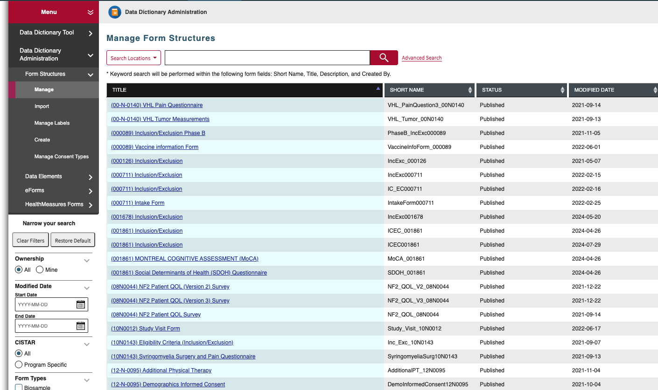
Form Structures

Slide 18
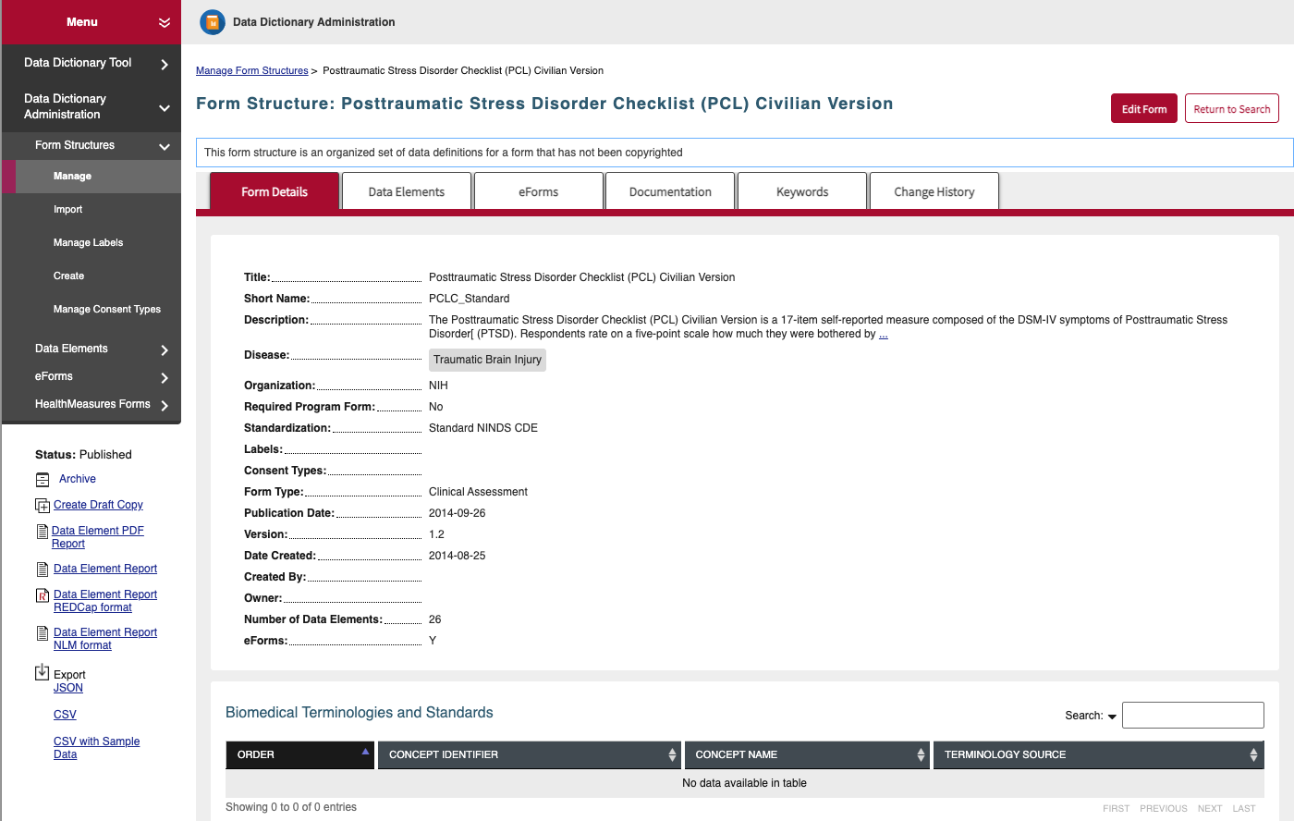
Form Structures

Slide 19
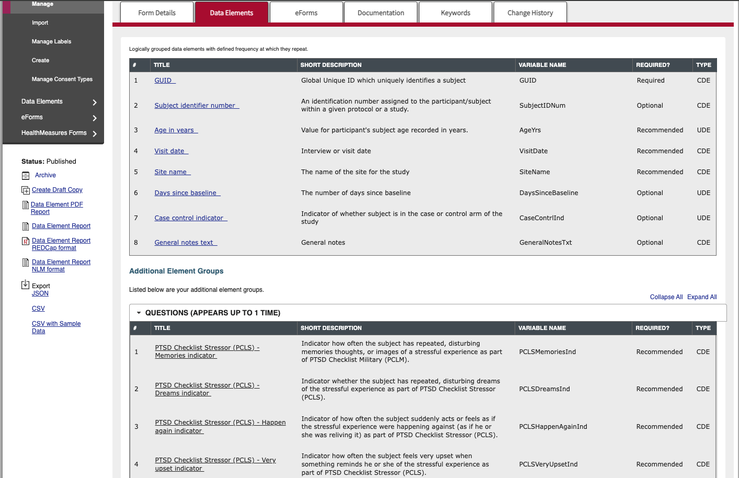
Form Structures

Slide 20
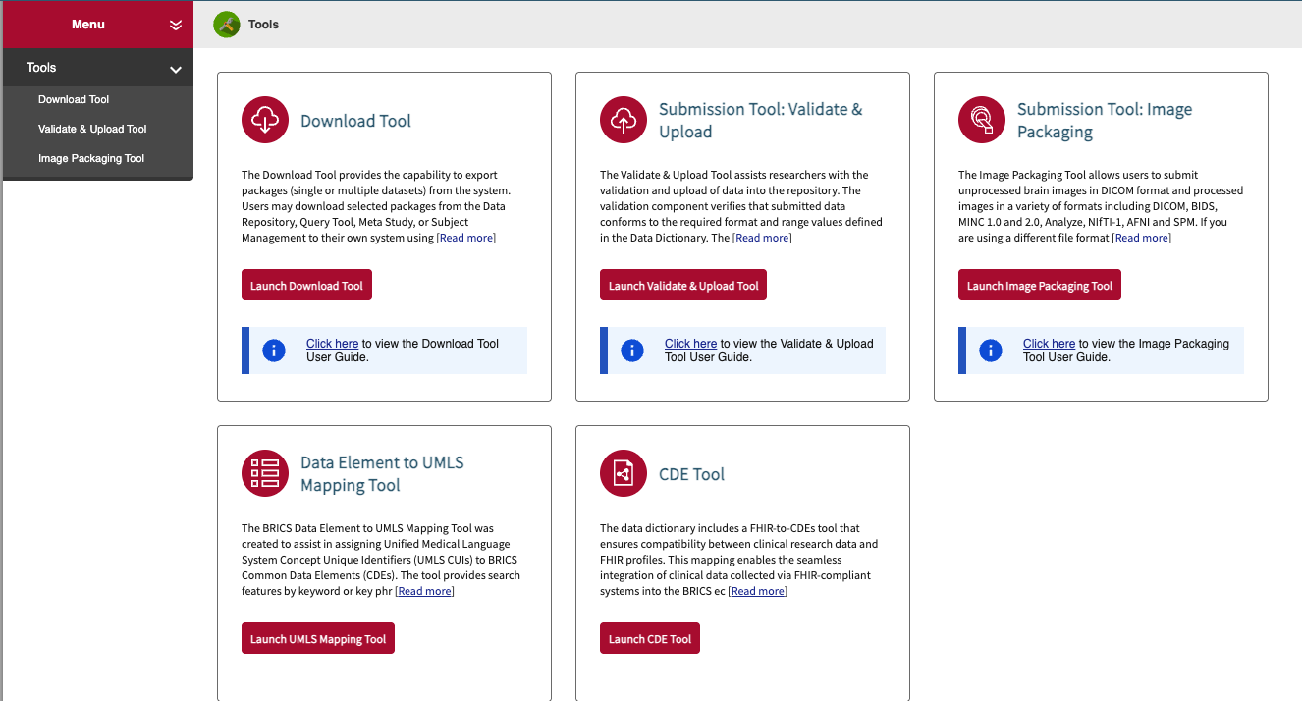
Tools

Slide 21
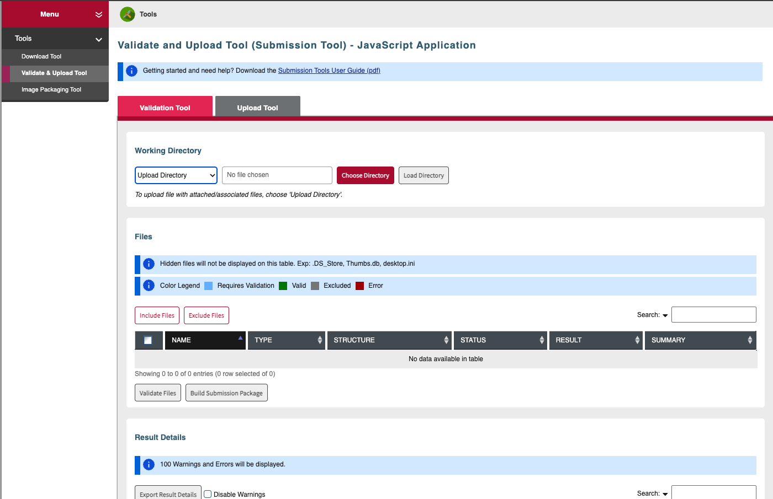
Upload and Submission Tools

Slide 22
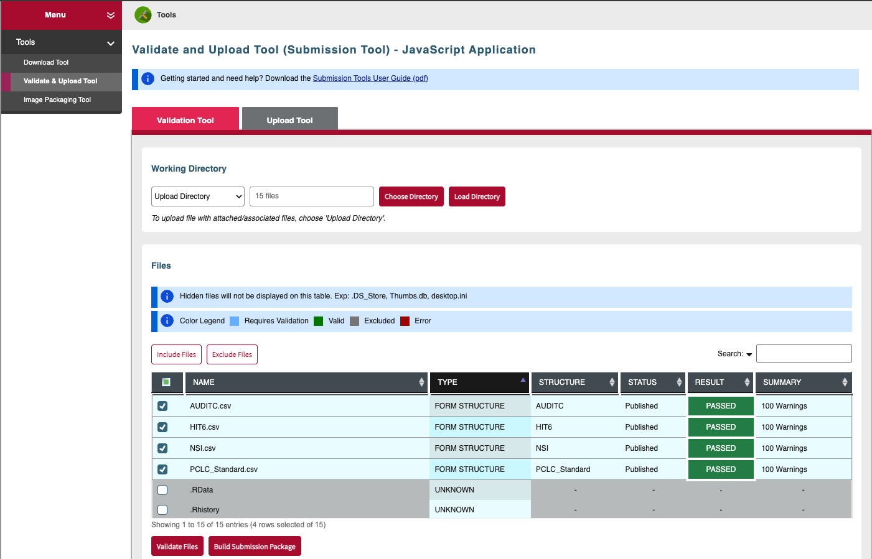
Upload and Submission Tools

Slide 23
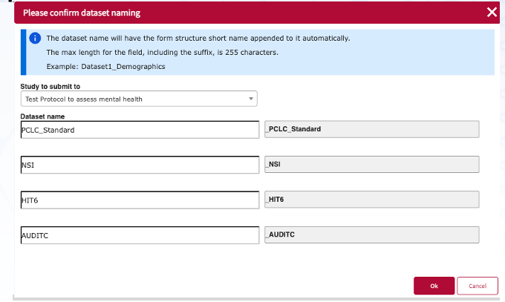
Upload

Slide 24
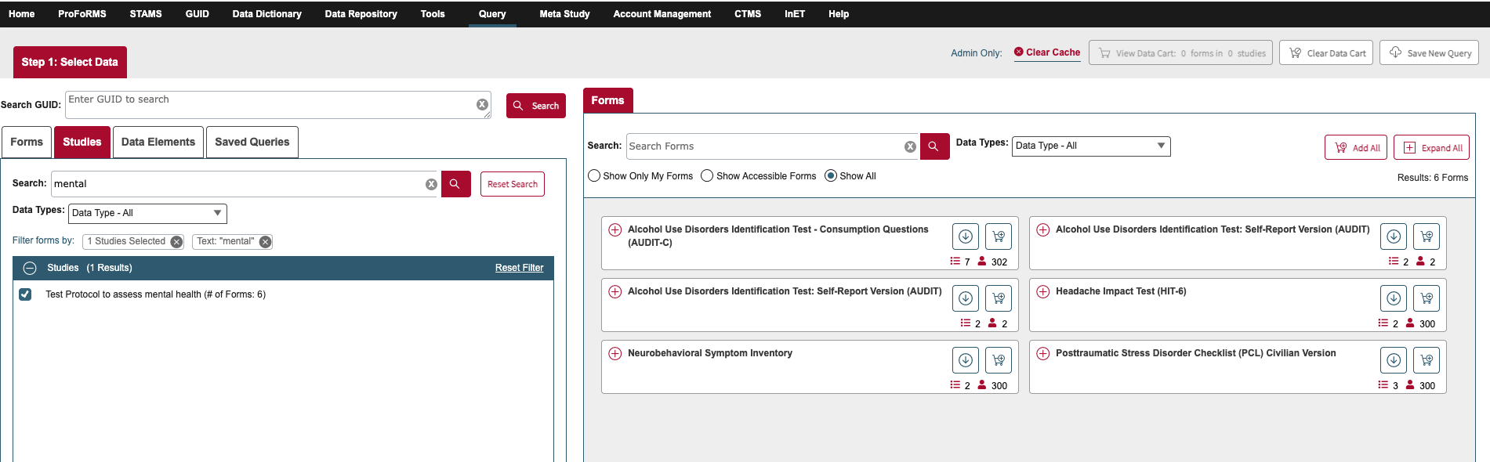
Query Tool

Slide 25
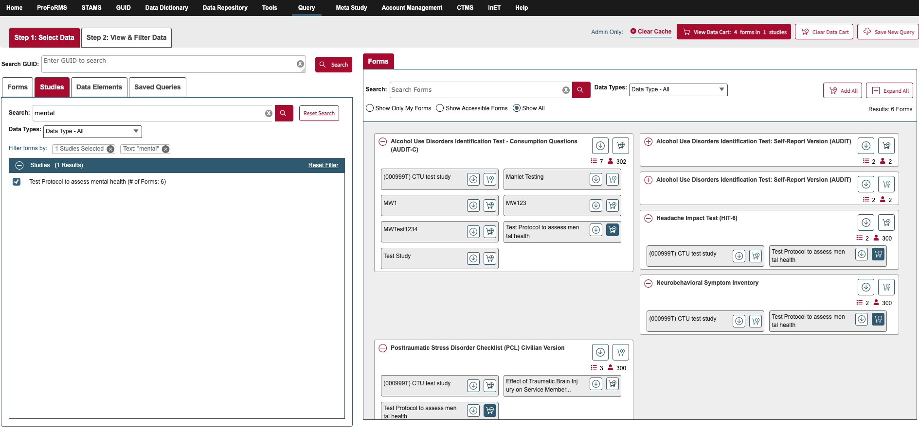
Query Tool

Slide 26
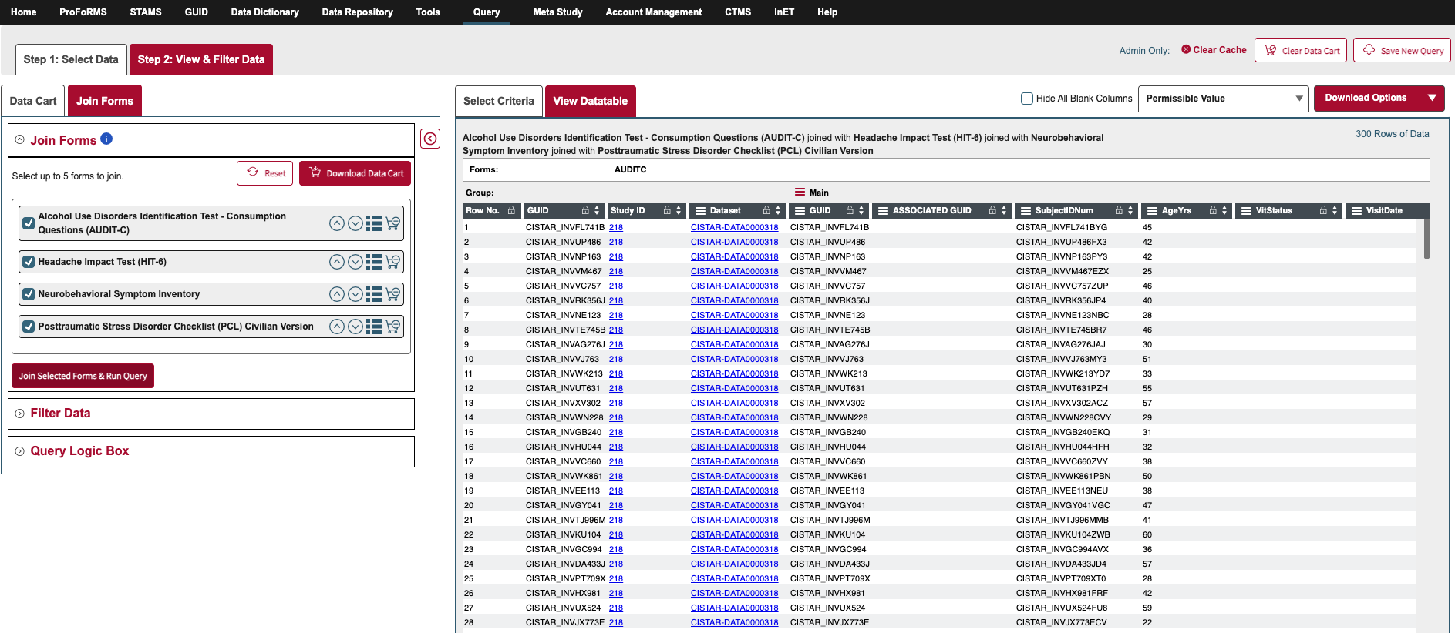
Query Tool

Slide 27
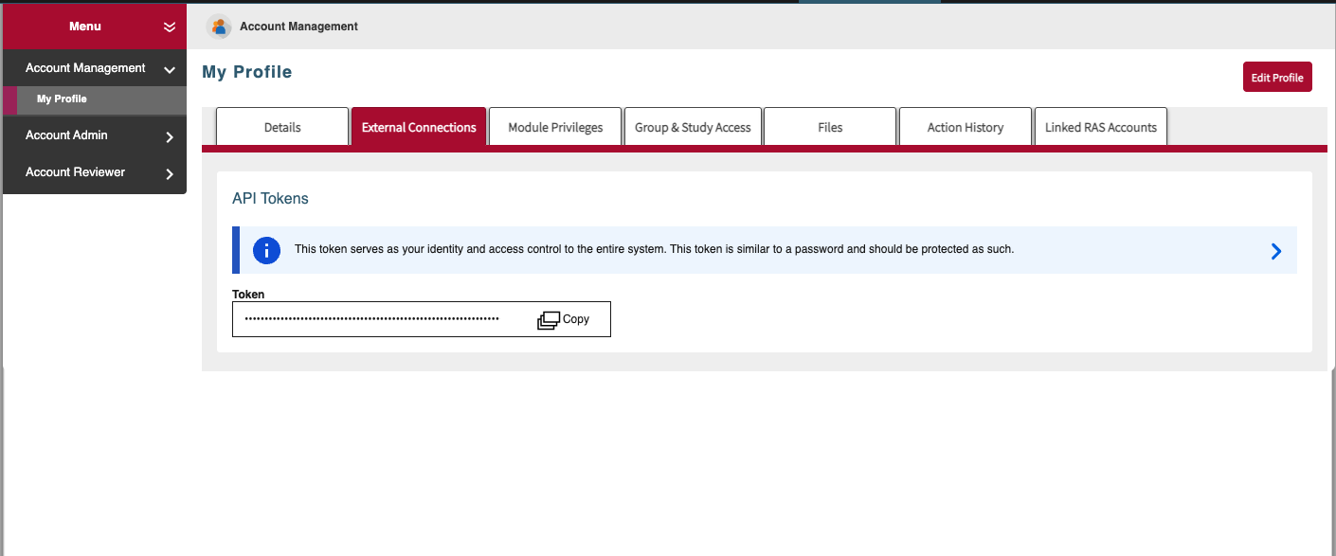
BRICS - API

Slide 28
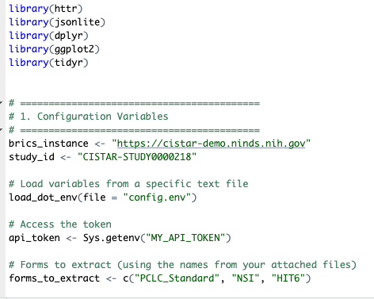
R Code – Part 1

Slide 29
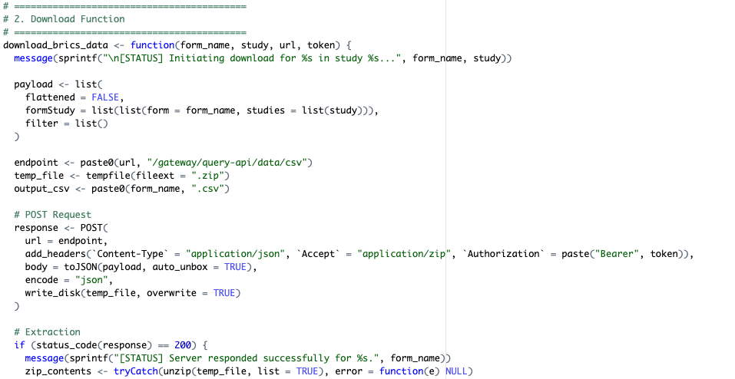
R Code – Part 2

Slide 30
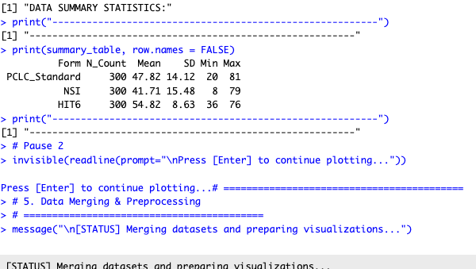
R Code – Part 3

Slide 31
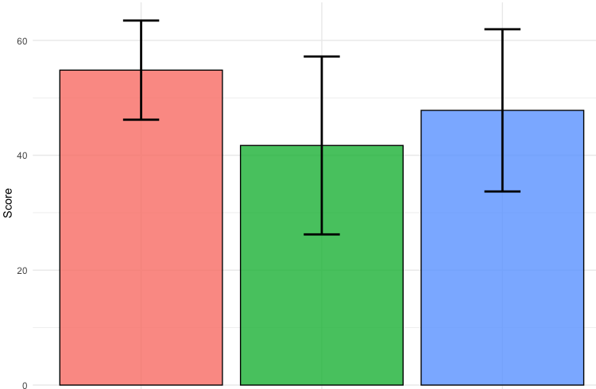
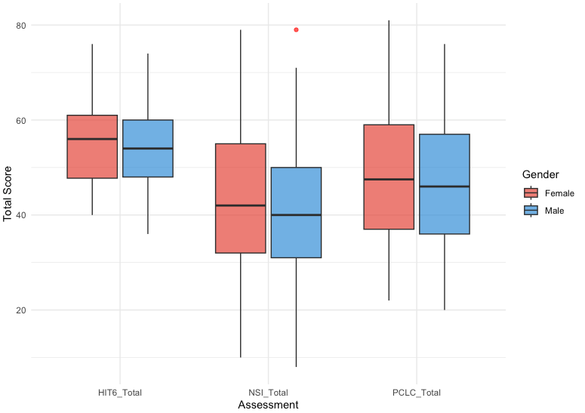
R Code – Part 4

Slide 32
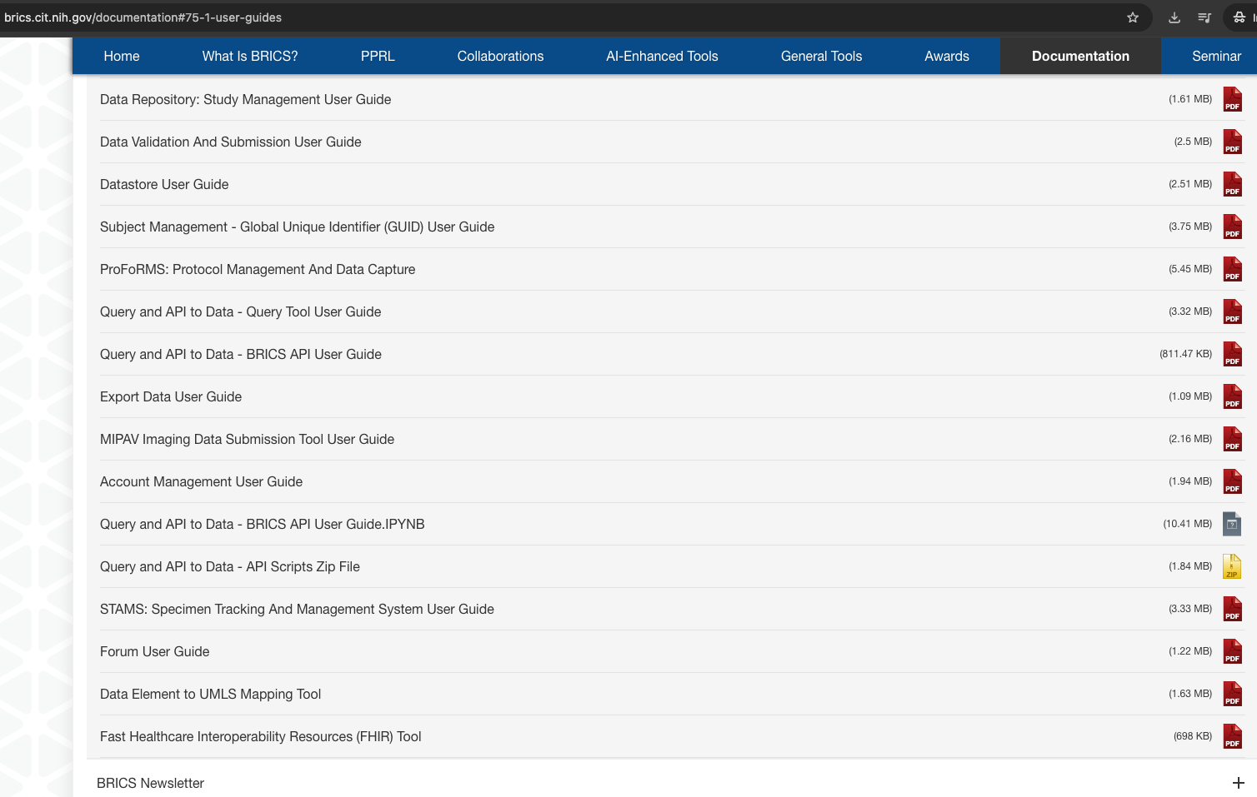
User Guides

Slide 33
Questions?

Slide 34

Thank you for joining in!
Will see you all on November 18th, 2026

