Slide 1
BRICS Seminar
BRICS Release List
Intramural Website – New BRICS Instance
BRICS Imaging
Biomedical Research Informatics Computing System (BRICS)
September 12th, 2024

Slide 2
Logistics
Audio/Video | Please keep your microphone muted
Recording | Today’s session will be recorded Will be posted on the BRICS website: https://brics.cit.nih.gov/demo
Questions & Comments | We encourage your participation today Please use the chat for questions & comments. The chat will be monitored throughout today’s demo. There will also be time after each speaker and at the end of the demo to ask live questions.

Slide 3
Agenda
Time | Topic | Speaker(s)
9:05 AM-9:15 AM | BRICS Release List | Dr. Matthew McAuliffe
9:15 AM–9:25 AM | New Intramural Instance | Dr. Matthew McAuliffe
9:25 AM-9:55 AM | BRICS Imaging | Evan McCreedy
9:55 AM-10:00 AM | Closing Remarks | Dr. Matthew McAuliffe

Slide 4
Biomedical Research Informatics Computing System (BRICS)
BRICS Release Items
Dr. Matthew McAuliffe

Slide 5
BRICS Release Items
Major UI Updates:
Enhanced User Experience: Redesigned the following interfaces for improved usability:
Accounts Module: Tabular format updates for better navigation, improved PIV/CAC smart card support, and UI updates for managing linked RAS accounts
Dictionary Module: Reorganized tab groupings, added consent type filters, and new export formats for data elements and form structures
Query Tool: Enhanced look and feel for studies, forms, and saved queries tabs, new filters for study access, and improved query logic box design
Meta Study: New Study State attributes and DOI minting functionality for unpublished meta studies

Slide 6
BRICS Release Items
Performance Enhancements:
Performance Improvements: Optimized database queries and enhanced system responsiveness across the various BRICS modules:
Data Dictionary - Faster Data Elements and Form Structure searches
Query Tool - Faster Initial Query Tool load
Data Repository - Improved View Studies load time
Accounts Module - Optimized Accounts module page responsiveness

Slide 7
BRICS Release Items
ProFoRMS & Tools Enhancements
Data Import Results Email: Improved email subject lines for clearer communication about import results
New "Tools" Module: Centralized access to Submission, Download, and Image Processing Tools for better user experience
CASA Merge:
Merged CASA User Stories: Integrated user stories from various CASA releases to streamline functionalities

Slide 8
BRICS Release Items
Data Dictionary & Repository Enhancements
New API Endpoints: API endpoint created for faster access to form structure associations, improving integration and automation capabilities
UMLS Mapping Tool: Users can now directly access the UMLS Mapping tool from the Data Element search page, streamlining the search and mapping process
FITBIR/NTRR Filters: Resource filters are now pre-checked, simplifying the search process for users with data access to both systems

Slide 9
BRICS Release Items
Query Tool & Meta Study Enhancements
Redesigned Query Tool UI: New layout for improved usability, including filters for study access (My Studies, Accessible Studies, Show All), and enhanced logic box design
Download Enhancements: Users can now download data directly from the right pane of the Query Tool, making data retrieval more intuitive
Form and Group Names Display: Updated scrolling feature to ensure form/group names remain visible when navigating large datasets
DOI Enhancements: Updated the DOI format for Repository and Meta Study modules for NEI and customized the landing pages for NEI instance

Slide 10
BRICS Release Items
Security Enhancements & Technical Updates
A&A Evaluation Process: BRICS instances have achieved NIST 800-53 Rev 5 certification
Apache Struts Migration (v6): Migrated to version 6 for enhanced security and performance, including updates to the Free Marker template
Spring & jQuery Upgrades: Upgraded Spring to version 5.3.33 and jQuery based on security vulnerability assessments, improving platform stability and security
DOI System Improvements: Enhanced the DOI assignment system for more accurate and reliable DOI generation for the pre-production environment

Slide 11
Biomedical Research Informatics Computing System (BRICS)
New Intramural BRICS Instance
Dr. Matthew McAuliffe

Slide 12
Intramural Website
New BRICS Instance: https://brics-intramural.cit.nih.gov/
Deployed on AWS Cloud (Under STRIDES)
Target Audience: Intramural researchers
Purpose:
Support making data FAIR and consistent with NIH’s new data sharing policy
Provide data aggregation and analysis
Explore and test various BRICS modules
Pilot:
ETL data from NIAID IMMPORT database
Important Note: This instance is for Testbed Only: Not approved for long-term data storage

Slide 13
Questions?

Slide 14
Biomedical Research Informatics Computing System (BRICS)
BRICS Imaging
Evan McCreedy

Slide 15
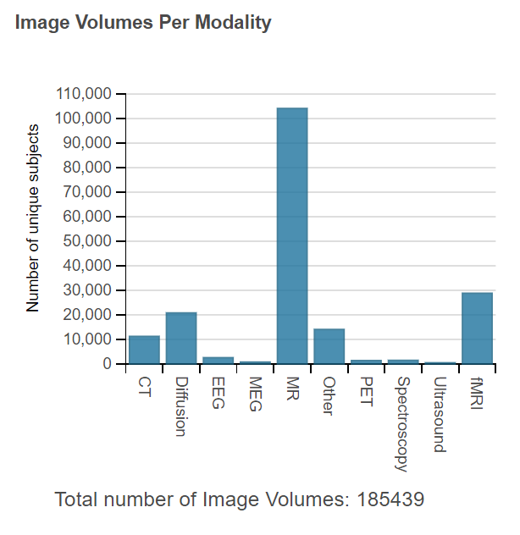
BRICS Imaging
Over 185,000 image volumes submitted to the FITBIR instance alone
Form structures for many clinical imaging modalities
Computed Tomography (CT)
Magnetic Resonance (MR)
Structural
Diffusion
Functional
Spectroscopy
Positron Emission Tomography (PET)
SPECT
MEG
Digital Pathology
And more…

Slide 16
BRICS Imaging
Image Packaging Tool
Extracts metadata from image headers, cross-mapping onto image form structure data elements
Checks for PII in DICOM headers
Organizes and harmonizes data for validation and upload
Supports 30+ medical imaging file formats, including
DICOM
NIfTI
BIDS (https://bids.neuroimaging.io/)

Slide 17
BRICS Imaging
Image Packaging Tool updates coming soon:
More efficient
Interface improvements
Support for the latest BIDS standard
Support for new DICOM variants

Slide 18
BRICS Imaging
BIDS support enables more groups to batch process image data without additional organizational work
For groups that need help organizing image data for submission, we create customized scripts to organize their data and process it through the Imaging Tool via batch processed CSVs

Slide 19
BRICS Imaging
Query Tool
Image data is integrated with clinical assessment and o-mics data in the Data Repository
Images can be viewed in-browser using VolView from the Query Tool results page

Slide 20
Demo

Slide 21
Questions?

Slide 22
Thank you for joining in!
Will see you all on October 10th, 2024!

