Slide 1
BRICS Demo
BRICS Intro and Video
BRICS Release Items – Spiderman, June 8, 2024
Specimen Tracking And Management System (STAMS)
Clinical Trials Management System (CTMS)
Biomedical Research Informatics Computing System (BRICS)
June 13th, 2024

Slide 2
Logistics
Audio/Video | Please keep your microphone muted
Recording | Today’s session will be recorded Will be posted on the BRICS website: https://brics.cit.nih.gov/demo
Questions & Comments | We encourage your participation today Please use the chat for questions & comments. The chat will be monitored throughout today’s demo. There will also be time after each speaker and at the end of the demo to ask live questions.

Slide 3
Agenda
Time | Topic | Speaker(s)
9:00 AM-9:15 AM | Introduction and BRICS Video | Dr. Matthew McAuliffe
9:15 AM-9:25 AM | BRICS Release Items – Spiderman, June 8, 2024 | Preeti Roy
9:25 AM-9:55 AM | Demo on STAM and CTMS modules | Dr. Dominic Nathan
9:55 AM-10:00 AM | Closing Remarks | Dr. Matthew McAuliffe

Slide 4
BRICS - Brief Introduction
Matthew J. McAuliffe, PhD (Biomedical Engineering)
Chief, Scientific Applications Services (SAS), CIT
Home | BRICS (nih.gov)
https://brics.cit.nih.gov

Slide 5
BRICS Video
https://youtu.be/eMNDrJp2LbI

Slide 6
Biomedical Research Informatics Computing System (BRICS)
Review Enhancements Latest BRICS Release
Preeti Roy

Slide 7
BRICS Release Notes
https://brics.cit.nih.gov/documentation
Spider-Man Enhancements:
Data Sharing upgrades under Meta Study module
Performance and usability upgrades in Accounts and Dictionary/Repository and Meta Study modules
Query Tool Enhancements
Work in Progress: Globus Integration; Mongo DB Migration

Slide 8
BRICS Release Notes
https://brics.cit.nih.gov/documentation
Data Sharing upgrades under Meta Study module
Added a new attribute to Create Meta Study Form to select Study State:
The meta study states that can be selected are:
1. Meta Analysis
2. Prospective
3. Retrospective.
Introduced Data Categories and reworked on the Data Type options.
Updated the filters in the left pane to reflect the new Data Type options.
Updated the Data Tables columns to display Study State, Data Type and Data Category.
Added a new feature for minting Draft DOIs to unpublished Meta Studies at the time of creating a new meta study.
Enabled and tested DOIs for NEI in the lower environment – This has been turned off in prod due to the request to change in formatting on the DOI links.

Slide 9
BRICS Release Notes
https://brics.cit.nih.gov/documentation
Performance and usability upgrades in Accounts and Dictionary/Repository and Meta Study modules
VA cards are now supported for RAS Authentication along with NIH PIV card and DoD CAC cards
Accounts Module: Converted accordions into tabs under various pages:
My Profile
Account List > Account Details Page
Account Renewal Page
Account Request Page
Account Reviewer Pages
Added Return to Search across the following modules:
Data Dictionary
Data Repository
Meta Study
Accounts
Optimized performance when searching for Data Elements or Form Structures in Dictionary

Slide 10
BRICS Release Notes
https://brics.cit.nih.gov/documentation
Query Tool Enhancements
Redesigned Query Tool:
Updated the look and feel of the Studies, Forms, Data Elements and Saved Queries tab.
Updated the look and feel of the Data Table View in the right pane.
Redesigned Data Cart UI components.
Implemented a new "Join Forms" tab beside the Data Cart for joining forms.
Enhanced the look and feel of the Query Tool Logic Box.
Added three new filters: 'Show Only My Studies', 'Show Accessible Studies', and 'Show All’.
Added a checkbox to include Associated Files in the Download to Queue popup.
Enabled display for PV/PVD upon hovering over the filters.

Slide 11
Demo

Slide 12
Biomedical Research Informatics Computing System (BRICS)
Demo on STAMS and CTMS modules
Dr. Dominic Nathan

Slide 13
STAMS: Specimen Tracking and Management Module
Dominic E. Nathan, PhD
Bioinformatics Director,
Military Traumatic Brain Injury Initiative
Uniformed Services University of the Health Sciences
(Contractor)

Slide 14
Disclaimer
“The presenter has no conflicts of interest to disclose. The views, information or content, and conclusions presented do not necessarily represent the official position or policy of, nor should any official endorsement be inferred on the part of, the Uniformed Services University, the Department of Defense, the U.S. Government, Department of Health and Human Services, National Institutes of Health, or the Henry M. Jackson Foundation for the Advancement of Military Medicine, Inc.”

Slide 16
STAMS - Use
Management of biosamples/specimens
Fluid samples
Tissue (blocks, slices, slab) samples
Brain tissue
Inventory of physical freezers and storage racks
Subject tracking
Protocols
Diagnosis
Other data
Manage user access and roles

Slide 17
STAMS
Notes:
Give a quick summary of what PROFROMS is – better than REDCAP

Slide 18
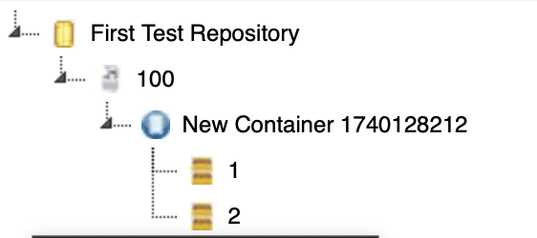
Repository Structure
STAMS Demo Repository
Repository Name
Freezer 1
Freezer Number
Rack 1
Freezer Rack
Freezer Boxes

Slide 19
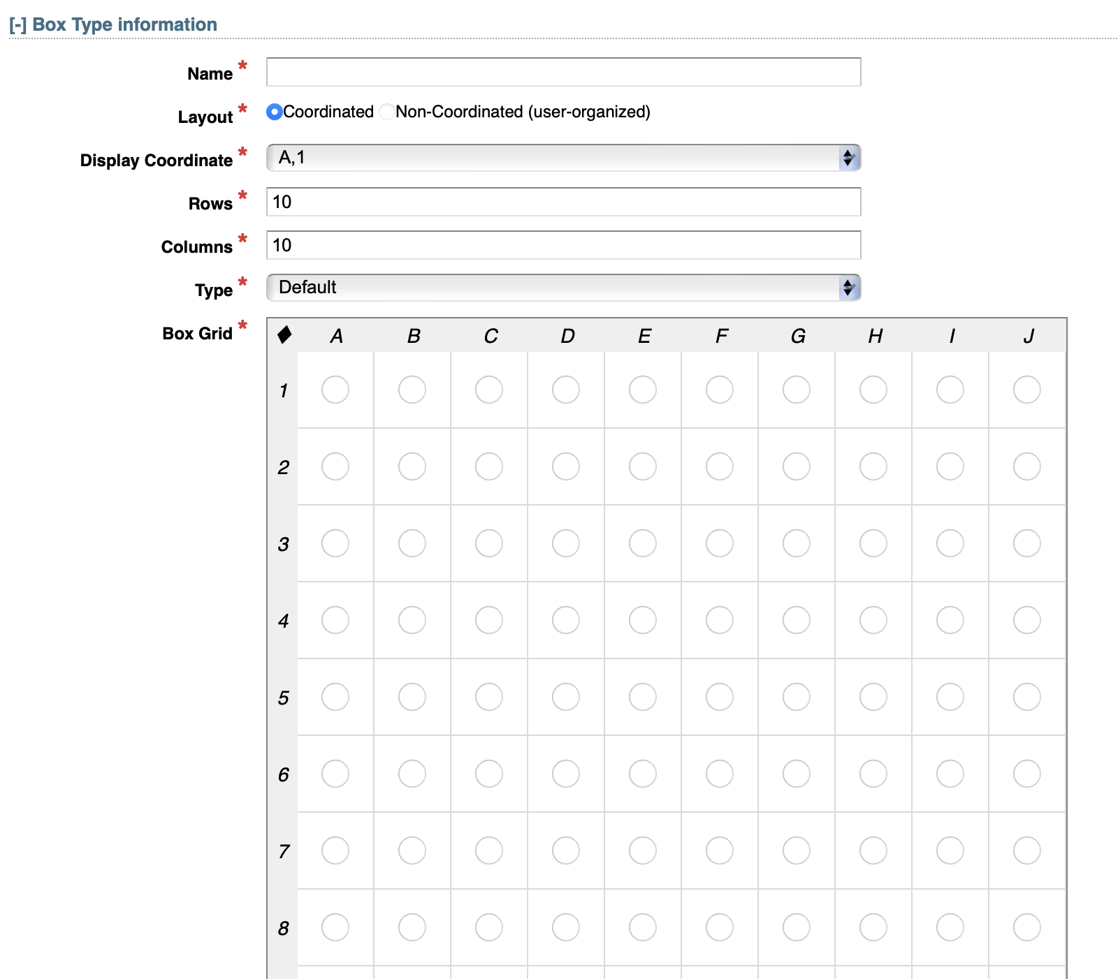
Box set up

Slide 20
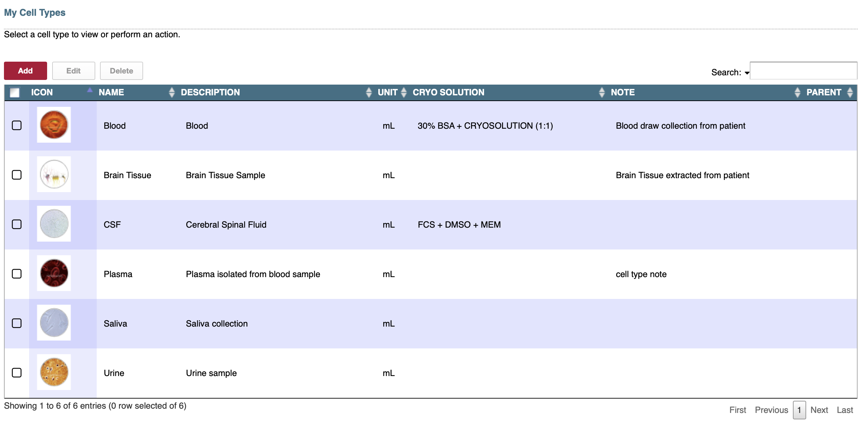
Cell types

Slide 21
Diagnosis

Slide 22
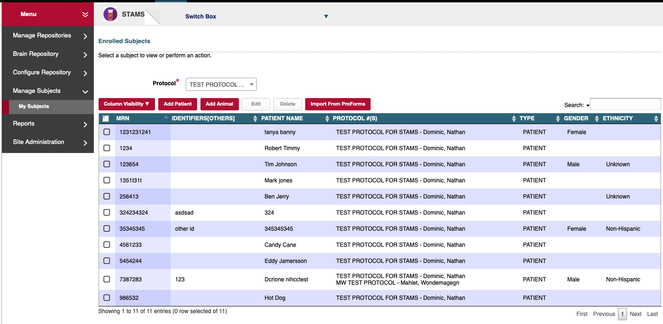
Adding Subjects

Slide 23
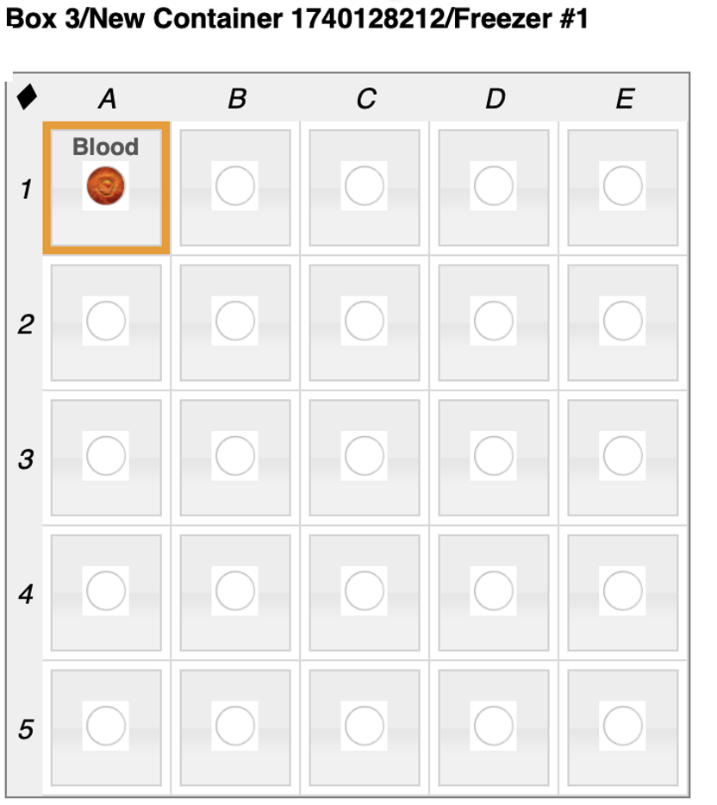
Example

Slide 24
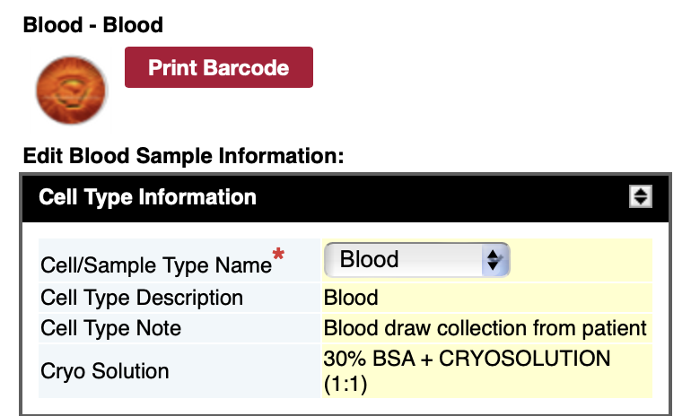
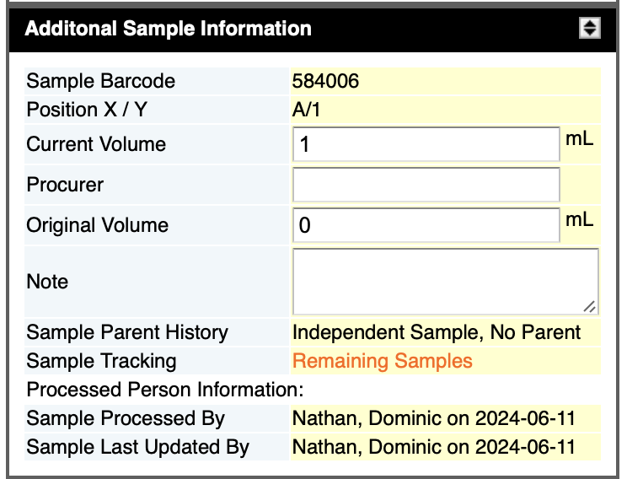
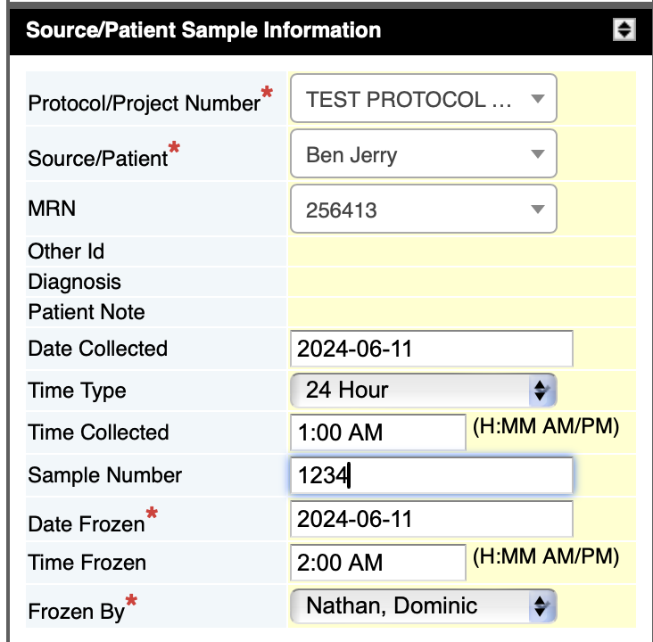
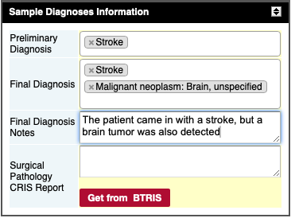
Adding a Sample

Slide 25
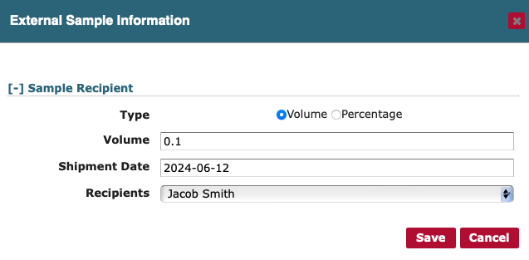
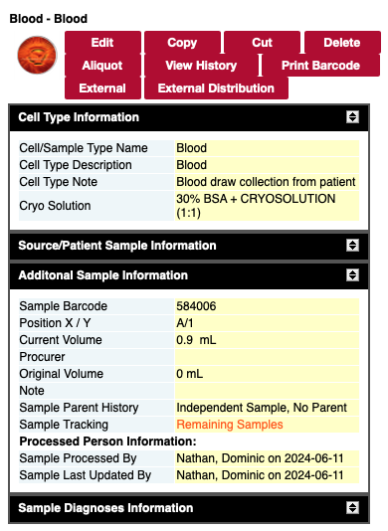
External Distribution

Slide 26
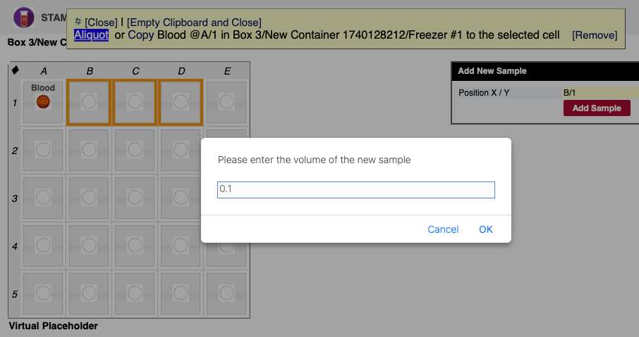
Aliquot

Slide 27
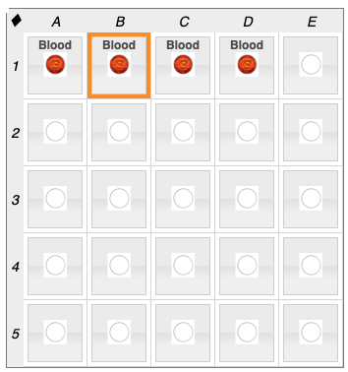
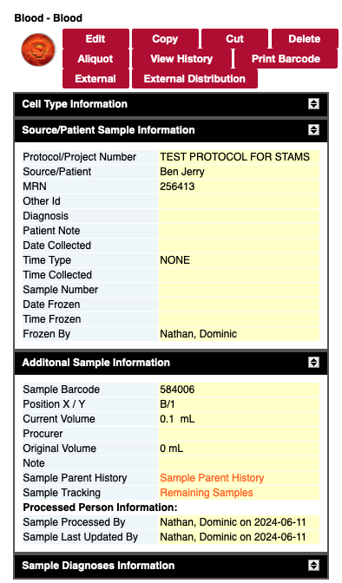
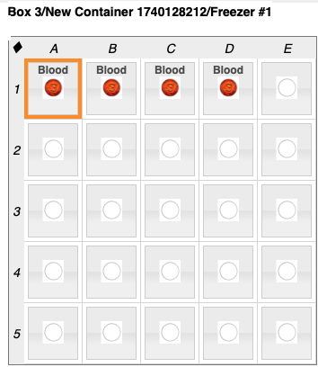
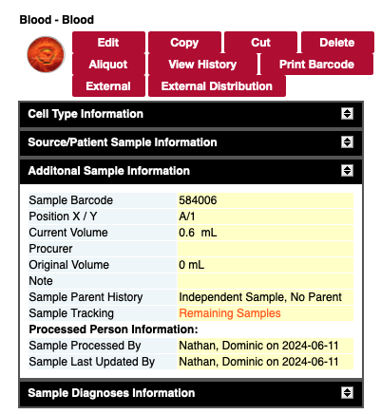
Aliquot

Slide 28
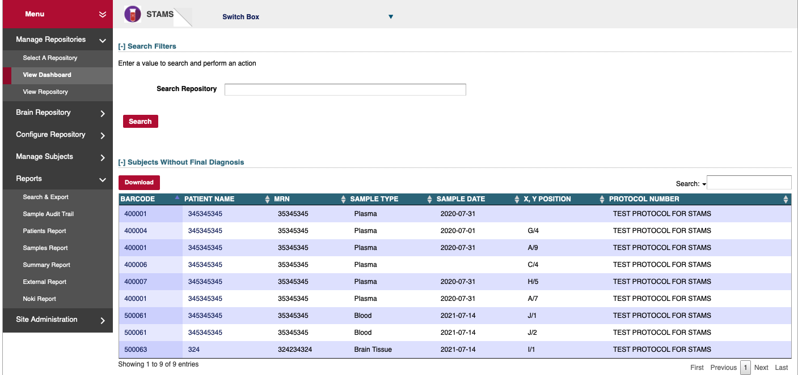
Search samples and sort

Slide 29
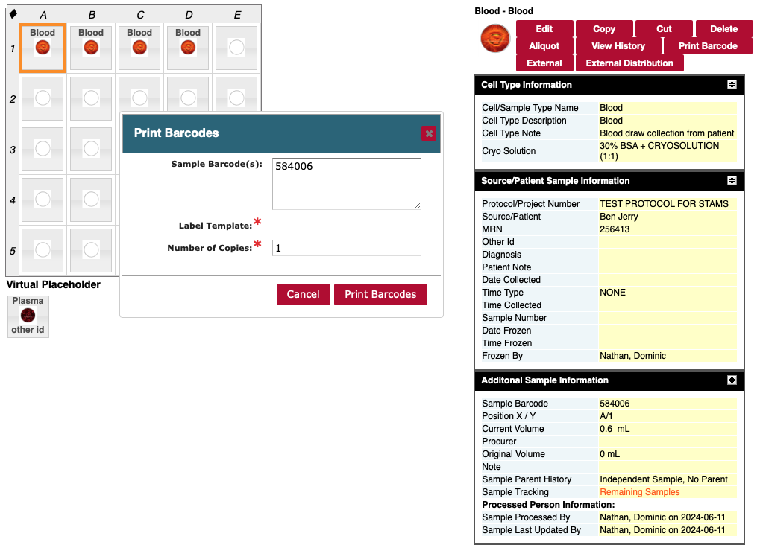
Label Printing

Slide 30
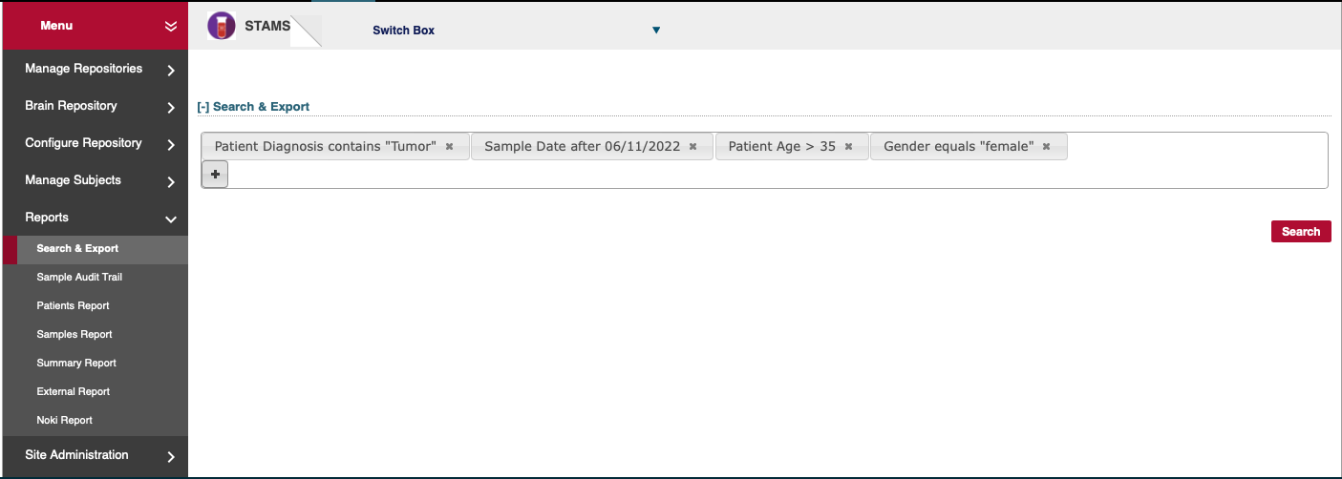
Reports

Slide 31
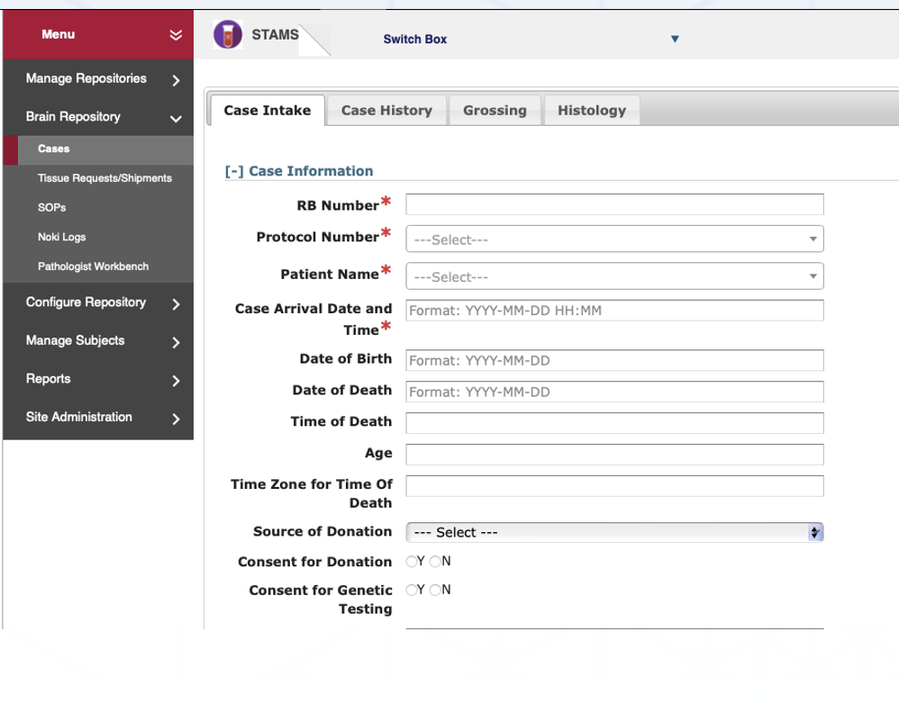
Brain Repository – Case Intake

Slide 32
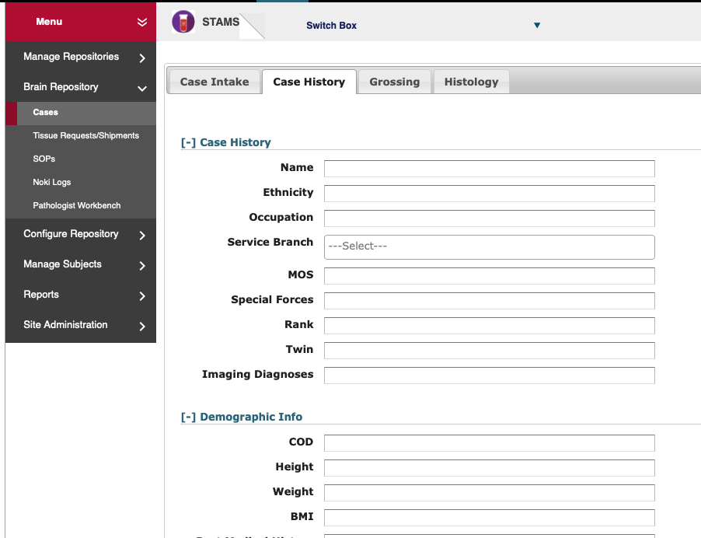
Brain Repository – Case History

Slide 33
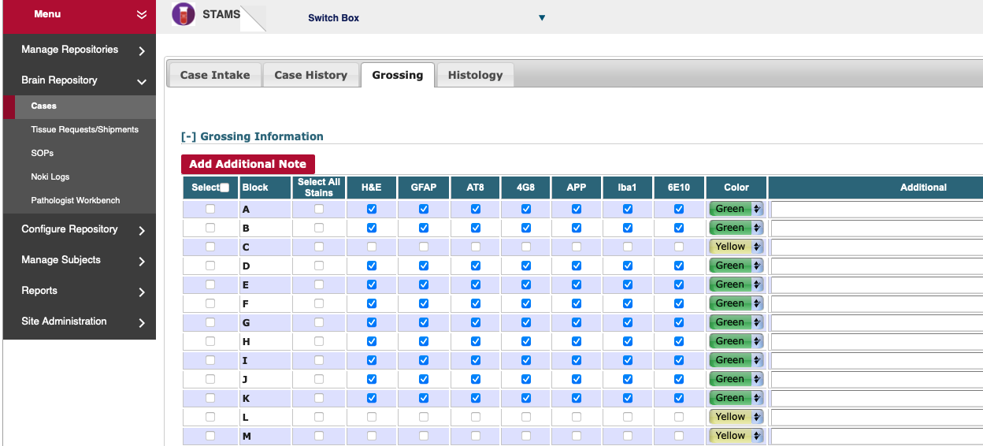
Brain Repository - Grossing

Slide 34
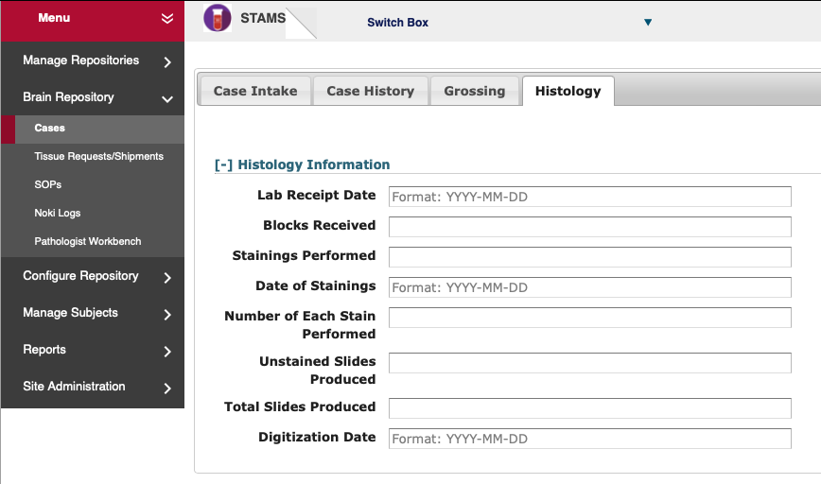
Brain Repository - Histology

Slide 35
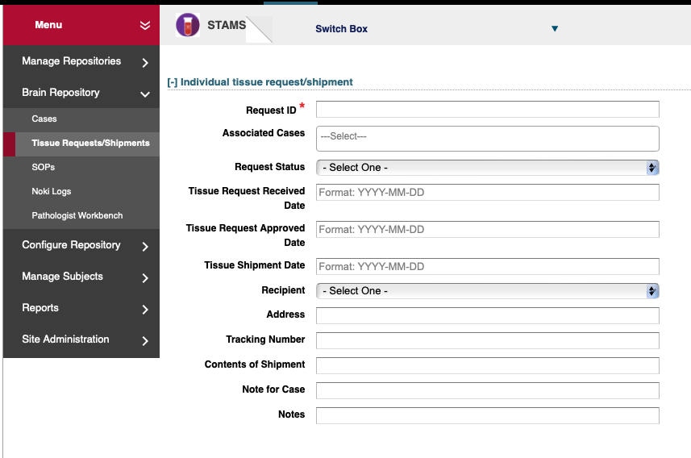
Brain Repository – Tissue Request/Shipment Tracking

Slide 36
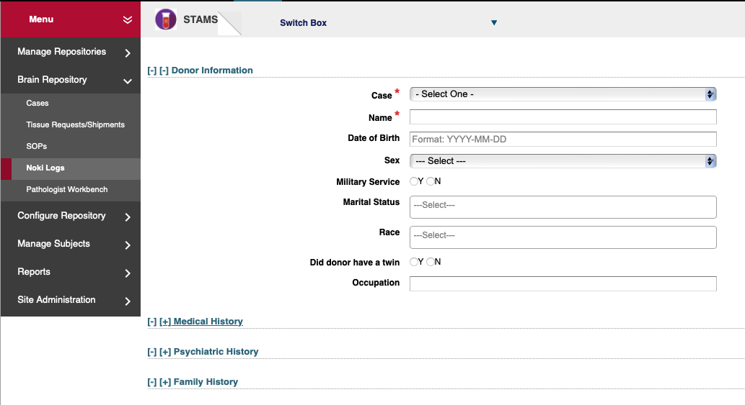
Brain Repository - NOKI

Slide 37
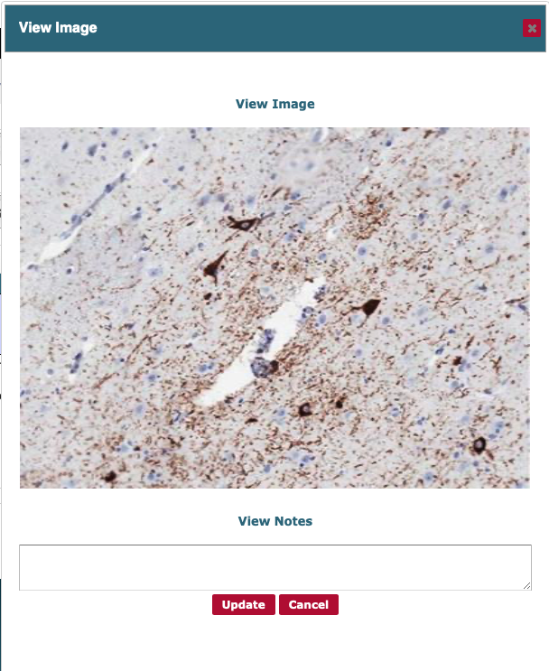
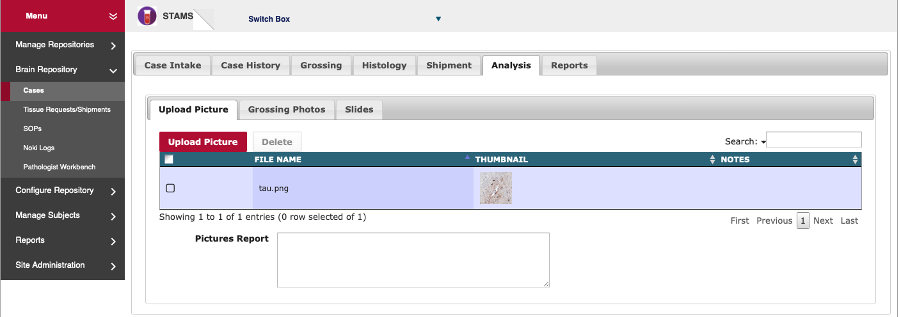
Analysis

Slide 38
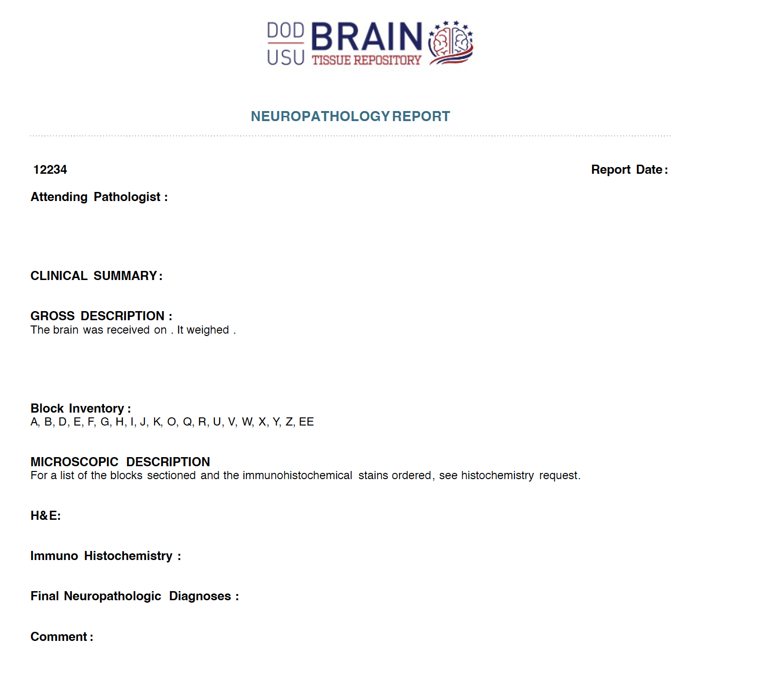
Report Generator

Slide 39
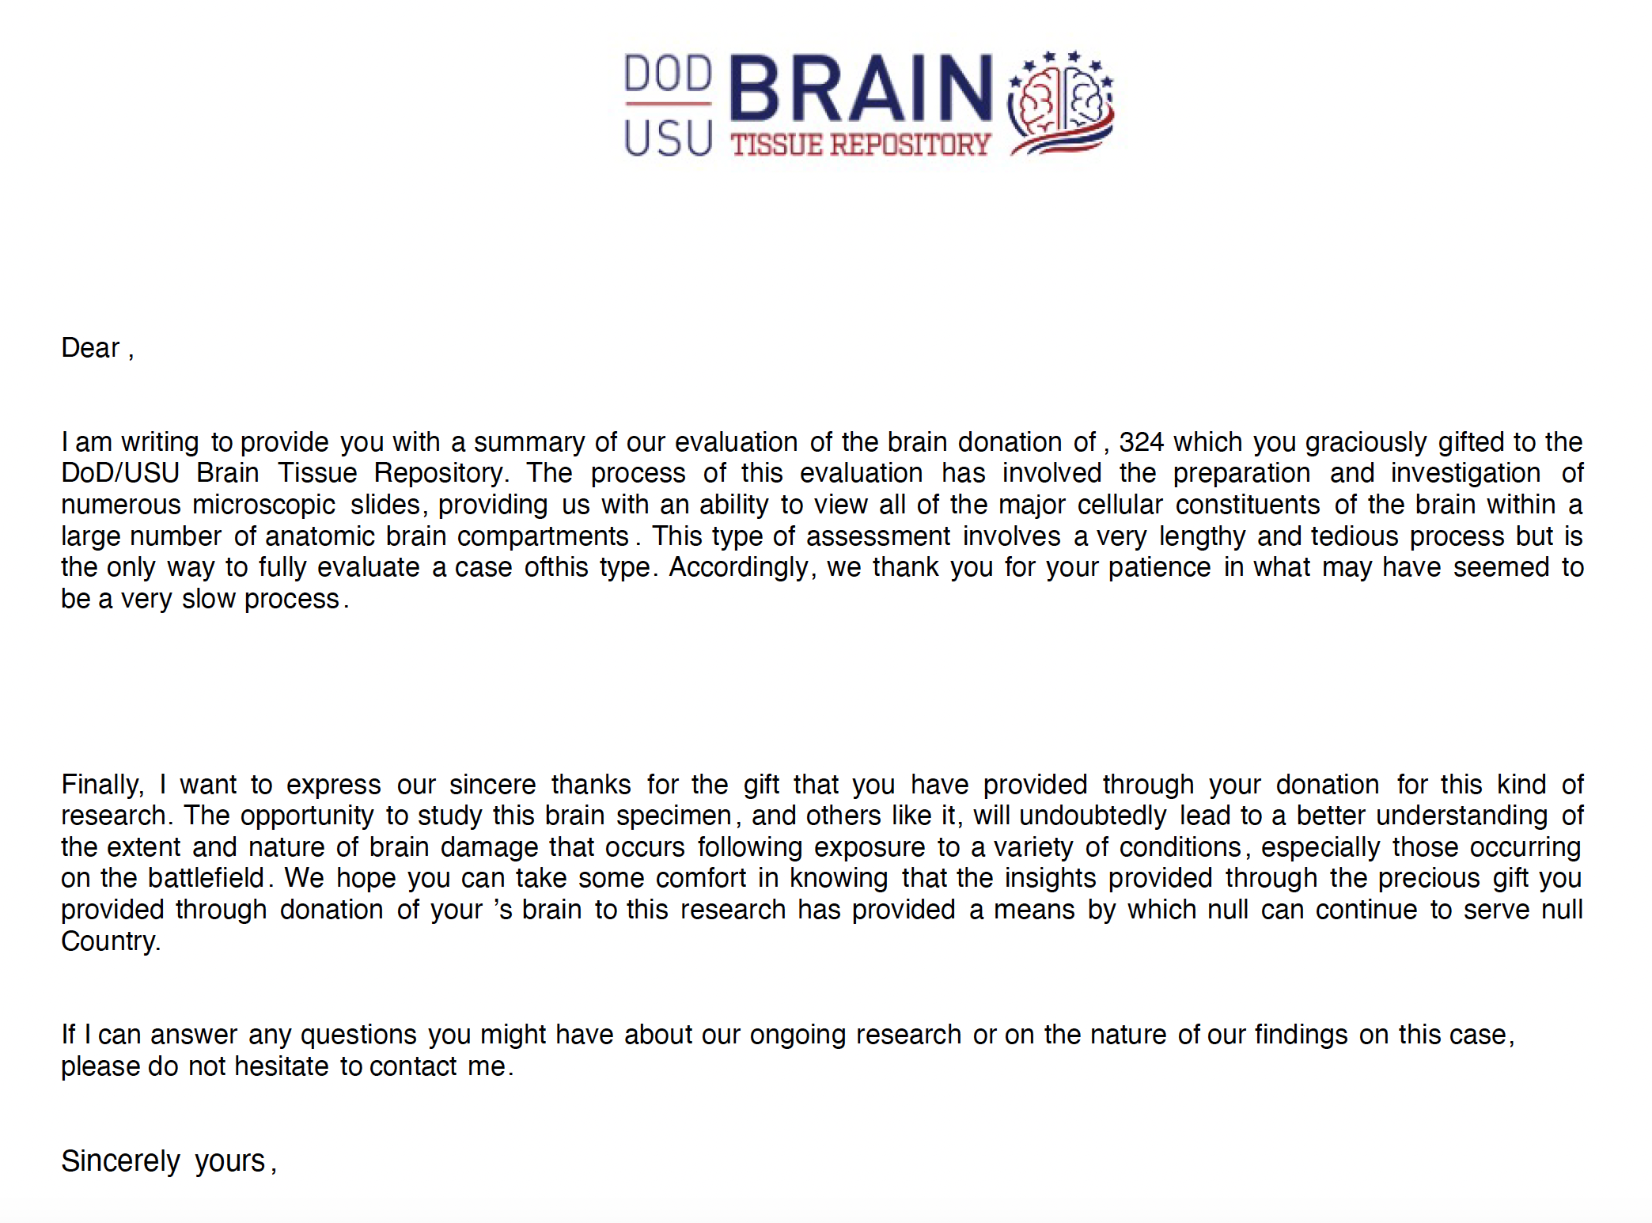
Report Generator

Slide 40
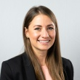
Acknowledgements
Dominic Nathan,
PHD Lead
Lan Wang
Lily Fan
Lloyd Dalias
Mahlet
Wondemagegn
Rohith
Vallabhaneni
Sindhu
Prasannakumar
Sireesha Kolla
Sridevi Sharvirala
Vivek Mannur
Alaa Haddad
Alex Trudov
Alexander
Burnett
Alexandra
Bokinsky
Alison Garcia
Andrea Lutz
Andy Van Avery
Basir Kader
Benjamin
Richmond
Brandi Williams
Christina Nguyen
Colton Farlow
Dagm Sirak
Dan Gillis
Derrick Fox
Erkan Ince
Erik Meyer
Fatima Irfan
Francis Chen
George Popkhadze
Henry Ogoe
Josh Eng
Joshua Park
Kevin Armengol
Krissy Treece
Lakshmi Katuri
Mallisa Johnson
Michelle Harris
Michael Strump
Mihir Bhave
Nalaka
Premathilaka
Nikhil Chamarthi
Nishith Pandya
Olga Vovk
Priya Raju
Preeti Roy
Rajeev
Nedumpally
Regina Ball
Ronnie Tan
Ryan Stewart-
Frederick
Sanghursh Jain
Scott Mitchell
Sid Ambarkar
Taylor Truong
Tuhin Zaman
Warren Overholt

Slide 41
We thank all our users, and contributors to the various working groups

Slide 42
Questions?

Slide 43
CTMS: Clinical Trials Management System
Dominic E. Nathan, PhD
Bioinformatics Director,
Military Traumatic Brain Injury Initiative
Uniformed Services University of the Health Sciences
(Contractor)

Slide 44
Disclaimer
“The presenter has no conflicts of interest to disclose. The views, information or content, and conclusions presented do not necessarily represent the official position or policy of, nor should any official endorsement be inferred on the part of, the Uniformed Services University, the Department of Defense, the U.S. Government, Department of Health and Human Services, National Institutes of Health, or the Henry M. Jackson Foundation for the Advancement of Military Medicine, Inc.”

Slide 46
CTMS - Use
Study management
Accrual
Study timelines
New Drug/Device – status, management, distribution, tracking
Monitoring
Pharmacy information
Personnel management
Publications
Management of study documents
Regulatory documents
IRB approvals, reviews, etc.
Consent forms
Trainings/certificates
Generate reports

Slide 47
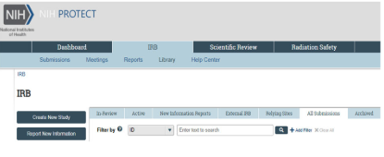
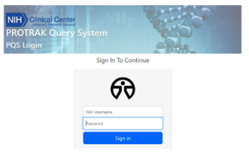
CTMS – Data Sources
PROTECT focuses on IRB information
PROTRAK focuses on CC
reporting/clinicaltrials.gov
Notes:
On January 17, 2023, the NIH IRB implemented PROTECT. ▪ PROTECT replaced iRIS as the electronic portal/platform for submission of new studies and all ongoing actions for IRB review. ▪ Studies that were IRB approved in iRIS and not closed, migrated to PROTECT. ▪ All studies that had not yet received initial IRB review in iRIS were “recreated” in PROTECT and received new IRB application/study numbers.

Slide 48
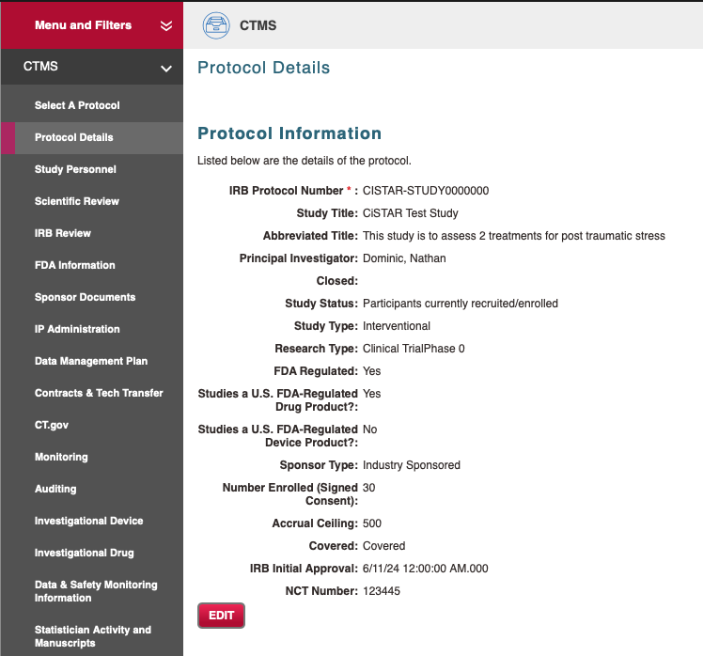
CTMS – Protocol Information

Slide 49
CTMS Study Personnel

Slide 50
Scientific Review

Slide 51
IRB Review

Slide 52
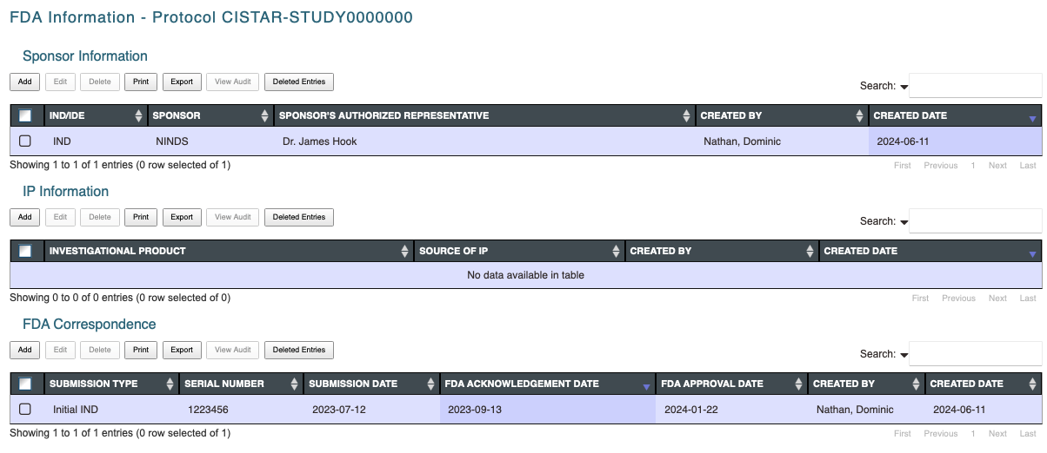
FDA Information

Slide 53
Sponsor Document

Slide 54
Data Management Plan

Slide 55
Monitoring

Slide 56
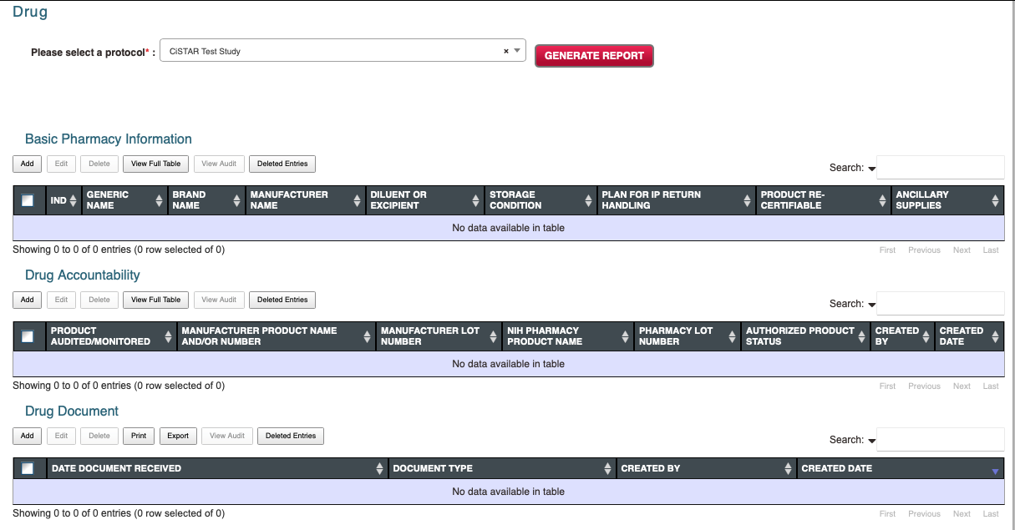
Investigational Drug

Slide 57
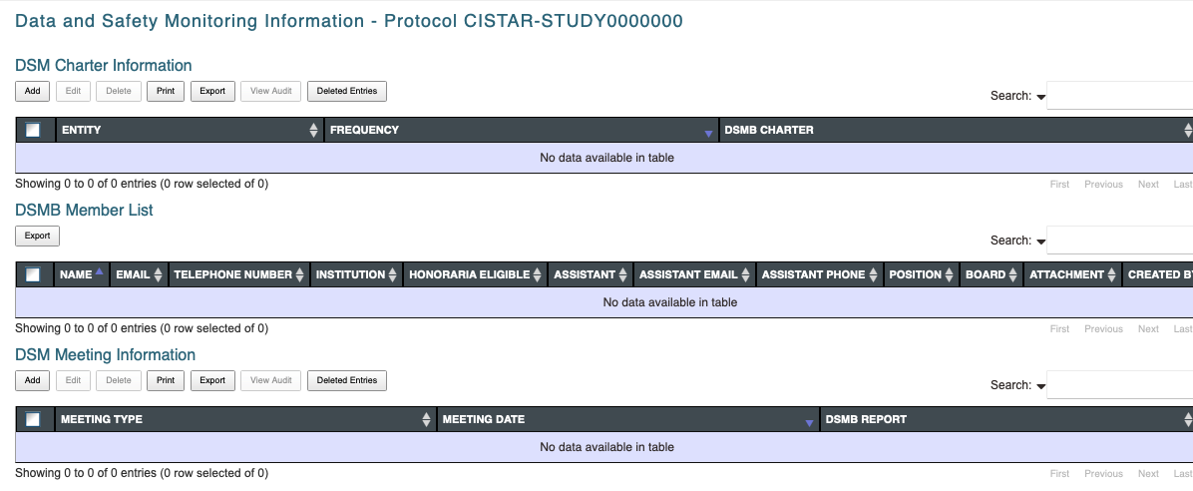
DSMB

Slide 58
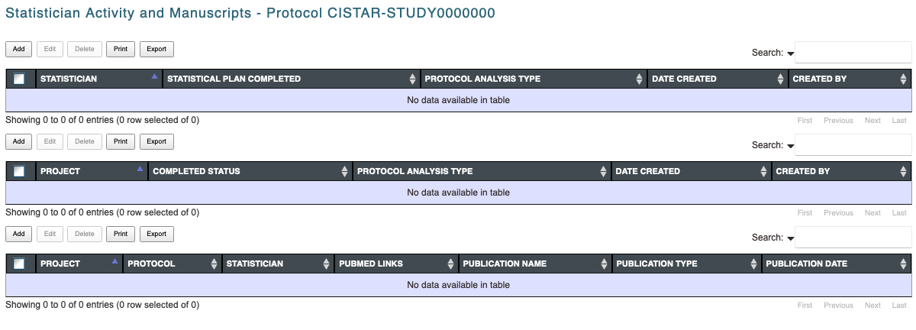
Statistician Activity and Manuscripts

Slide 59
Other reports
Adverse event
Protocol non compliance
Training records, licenses, annual review

Slide 60
Acknowledgements
Dominic Nathan,
PHD Lead
Lan Wang
Lily Fan
Lloyd Dalias
Mahlet
Wondemagegn
Rohith
Vallabhaneni
Sindhu
Prasannakumar
Sireesha Kolla
Sridevi Sharvirala
Vivek Mannur
Alaa Haddad
Alex Trudov
Alexander
Burnett
Alexandra
Bokinsky
Alison Garcia
Andrea Lutz
Andy Van Avery
Basir Kader
Benjamin
Richmond
Brandi Williams
Christina Nguyen
Colton Farlow
Dagm Sirak
Dan Gillis
Derrick Fox
Erkan Ince
Erik Meyer
Fatima Irfan
Francis Chen
George Popkhadze
Henry Ogoe
Josh Eng
Joshua Park
Kevin Armengol
Krissy Treece
Lakshmi Katuri
Mallisa Johnson
Michelle Harris
Michael Strump
Mihir Bhave
Nalaka
Premathilaka
Nikhil Chamarthi
Nishith Pandya
Olga Vovk
Priya Raju
Preeti Roy
Rajeev
Nedumpally
Regina Ball
Ronnie Tan
Ryan Stewart-
Frederick
Sanghursh Jain
Scott Mitchell
Sid Ambarkar
Taylor Truong
Tuhin Zaman
Warren Overholt

Slide 61
We thank all our users, and contributors to the various working groups

Slide 62
Questions?

Slide 63
Thank you for joining in!
Will see you all in September, 2024!

