Slide 1
BRICS Demo
Data Discovery Tool
Biomedical Research Informatics Computing System (BRICS)
May 9th, 2024

Slide 2
Logistics
Audio/Video | Please keep your microphone muted
Recording | Today’s session will be recorded Will be posted on the BRICS website: https://brics.cit.nih.gov/demo
Questions & Comments | We encourage your participation today Please use the chat for questions & comments. The chat will be monitored throughout today’s demo. There will also be time after each speaker and at the end of the demo to ask live questions.

Slide 3
Agenda
Time | Topic | Speaker(s)
9:00 AM-9:15 AM | Introduction | Dr. Matthew McAuliffe
9:15 AM-9:55 AM | Demo on Data Discovery Tool | Dr. Alexandra Bokinsky
9:55 AM-10:00 AM | Questions & Closing Remarks | Dr. Matthew McAuliffe

Slide 4
https://web.cvent.com/event/b1808ba5-fb93-4bf9-a253-dc63938869a9/summary

Slide 5
BRICS - Brief Introduction
Matthew J. McAuliffe, PhD (Biomedical Engineering)
Chief, Scientific Applications Services (SAS), CIT
Home | BRICS (nih.gov)
https://brics.cit.nih.gov

Slide 6
Building from existing projects
National Database for Autism Research (NDAR)
GOVERNMENT SYSTEMS
GOVERNMENT INITIATIVES
Federal Interagency Traumatic Brain Injury Research Informatics System (FITBIR)
Medical Image Processing, Analysis and Visualization (MIPAV)
Parkinson’s Disease Biomarker Program (PDBP)
NIH Strategic Plan for Data Science & FAIR - ODSS
National PhenotypingOphthalmic Disease Genotyping and Network (eyeGENE®
BRICS
System
Open Source
NICHD Clinical Trial Database (CTDB)
Center for Neuroscience and Regenerative Medicine (CNRM)
Common Data Elements (CDE TF)
Clinical Informatics System for Trials and Research (CiSTAR)
Global Rare Diseases Repository (GRDR)
Trans-NIH BioMedical Informatics Coordinating Committee
(BMIC)
Common Data Repository for Nursing Science (cdRNS)
National Trauma Institute (NTI)
14th Annual Excellence.gov Awards Overall winner
Notes:
Option 1

Slide 7
BRICS
Mesh And Fabric
FITBIR
Accounts
ProFoRMS
Subject Mgmt.
Data Repository
Query
Meta Study
PDBP
Accounts
ProFoRMS
Subject Mgmt.
Data Dictionary
Data Repository
Query
Meta Study
cdRNS
Accounts
ProFoRMS
Subject Mgmt.
Data Dictionary
Data Repository
Query
Meta Study
eyeGENE
Accounts
ProFoRMS
Subject Mgmt.
Data Dictionary
Data Repository
Query
Meta Study
NIA
Accounts
Subject Mgmt.
NINDS
Accounts
Subject Mgmt.
GRDR
Accounts
Subject Mgmt.
BRICS Intramural
Accounts
ProFoRMS
Subject Mgmt.
Data Dictionary
Data Repository
Query
Meta Study
Centralized Global Unique Identifier (GUID:PPRL)
Shared Data Dictionary
On Premise
Cloud
On Premise
On Premise
On Premise
On Premise
On Premise
Cloud
Datatypes: Phenotypic, Imaging, and Omics

Slide 8
Upcoming Releases
Spiderman Release: (June 2024)
Real time saving of locked ProFoRMS data to the repository (Migrating to Mongo DB from PostGres)
Submission Tool | Globus Integration
UI Enhancements for the Accounts, Meta Study and Query Tool modules
Tech library updates as needed
Various UI and feature enhancements across the BRICS modules

Slide 9
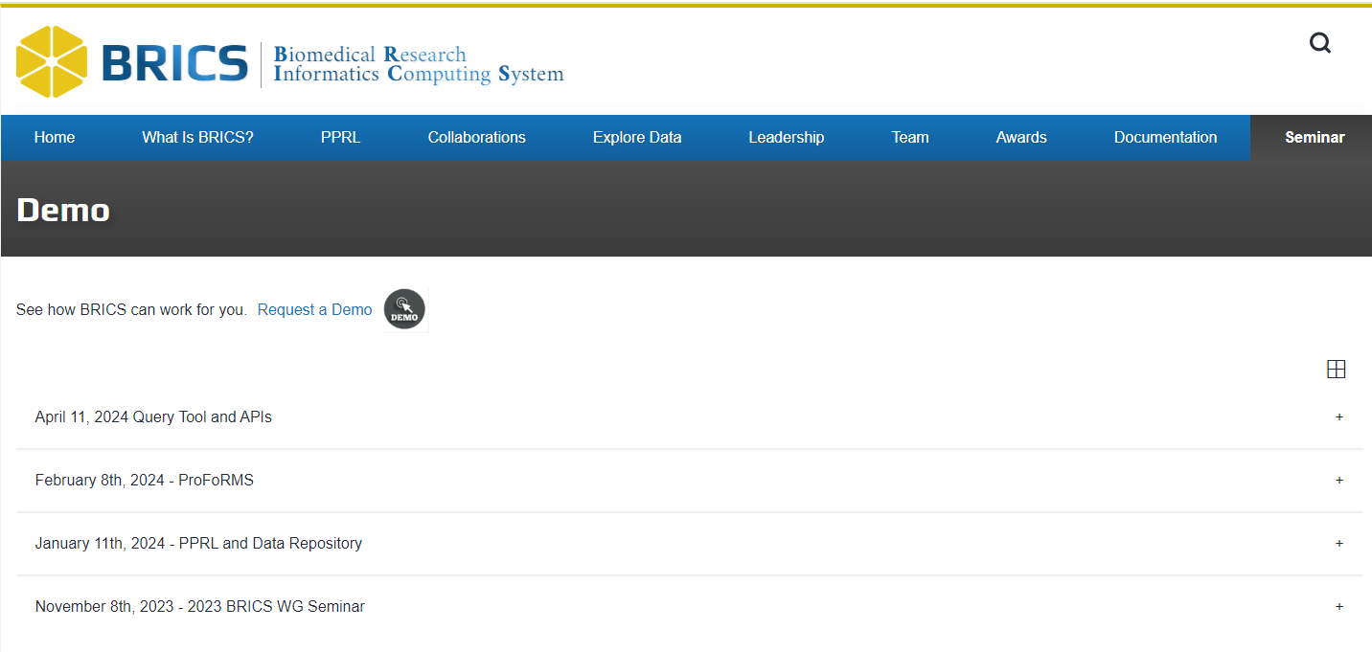
https://brics.cit.nih.gov/demo

Slide 10
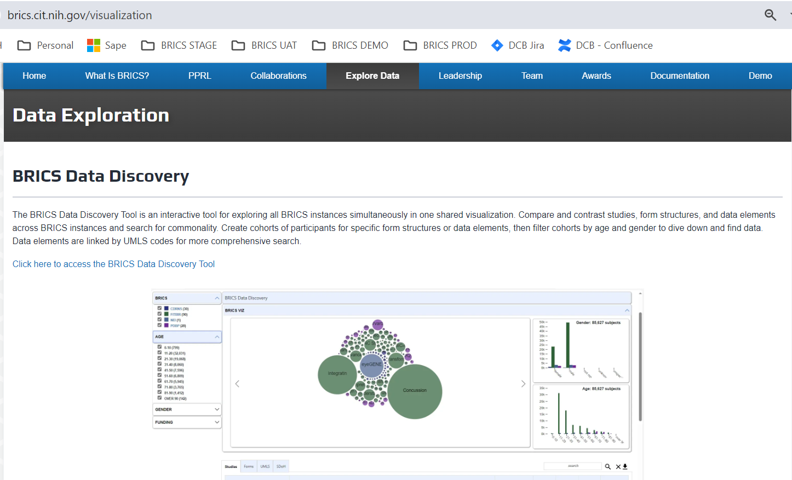

Slide 11
Biomedical Research Informatics Computing System (BRICS)
BRICS Data Discovery
Dr. Alexandra Bokinsky

Slide 12
BRICS Data Discovery
https://brics.cit.nih.gov/visualization
Publicly Accessible Interactive Dashboard
Integrate data across 85,627 subjects, 149 studies and 4 BRICS repositories.

Slide 13
BRICS Data Discovery
https://brics.cit.nih.gov/visualization
Explore BRICS Repositories & Search for Commonality
Common Data Elements (CDEs)
Which CDEs are shared across repositories?
Form Structures
Which studies use similar form structures?
Find studies collecting similar data
Which studies collect the same metrics?
Find larger, more diverse cohorts
Where can I find subjects with MoCA scores?
Attract new researchers to apply for data access
Which BRICS repositories contain data I’m looking for?
Foster Collaboration
Connect with other researchers

Slide 14
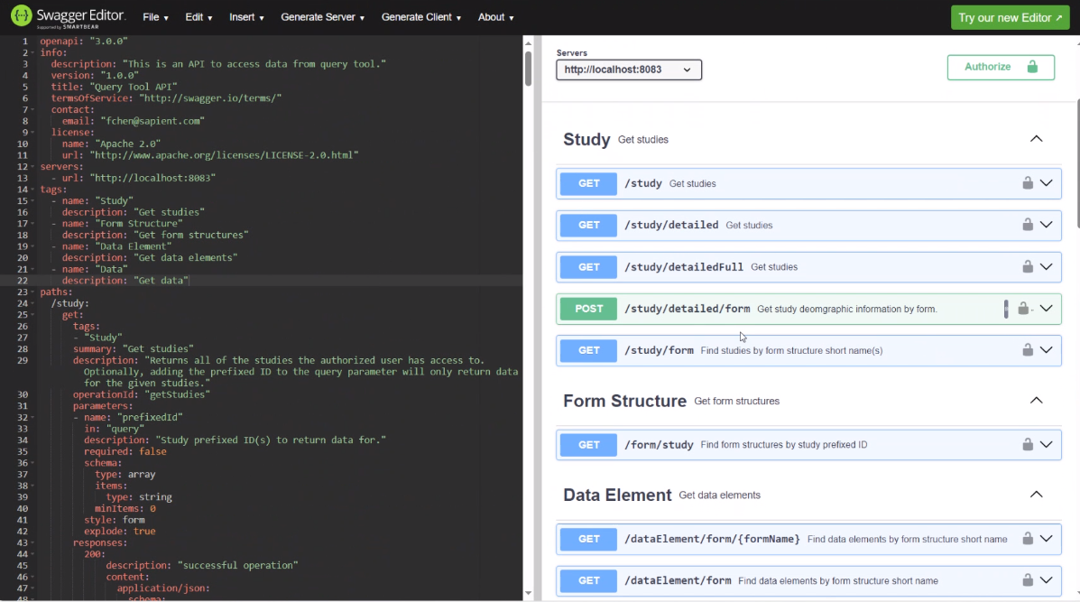
BRICS Data Discovery
https://brics.cit.nih.gov/visualization
API Query Tool
Programmatic access to the data
Authenticate RAS (11/2023)
Query
Retrieve data
Analysis
FITBIR
Data
Rest
API
PDBP
Data
Researcher
Data Scientist
Visualization
Jupyter Notebooks
Python, R,
AI/ML libraries
JavaScript
Rest
API
BRICS Informatics
Systems
Notes:
Redesign

Slide 15
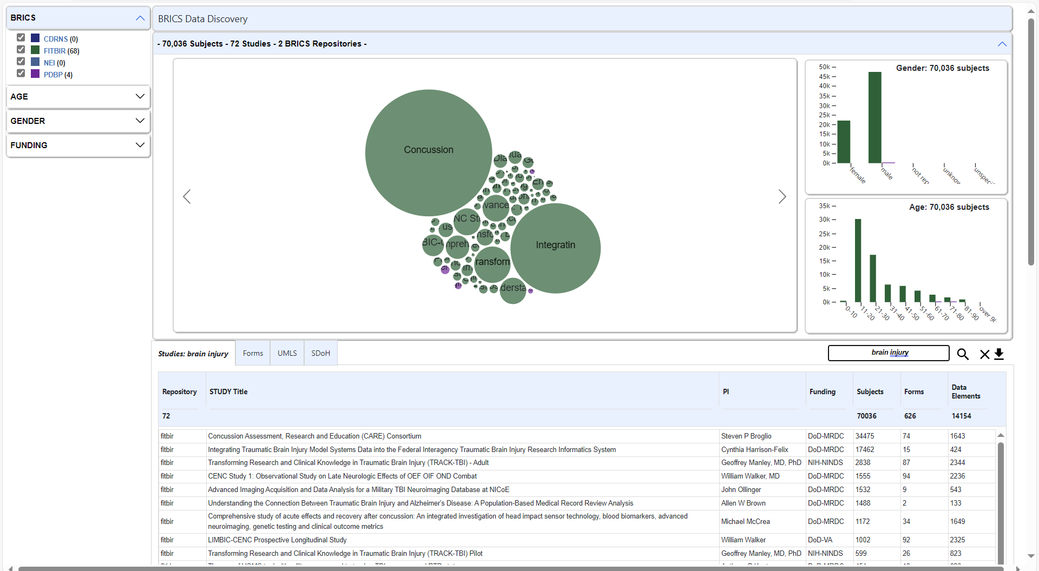
BRICS Data Discovery
https://brics.cit.nih.gov/visualization
Keyword Search: brain injury
70,036 Subjects – 72 Studies – 2 Repositories

Slide 16
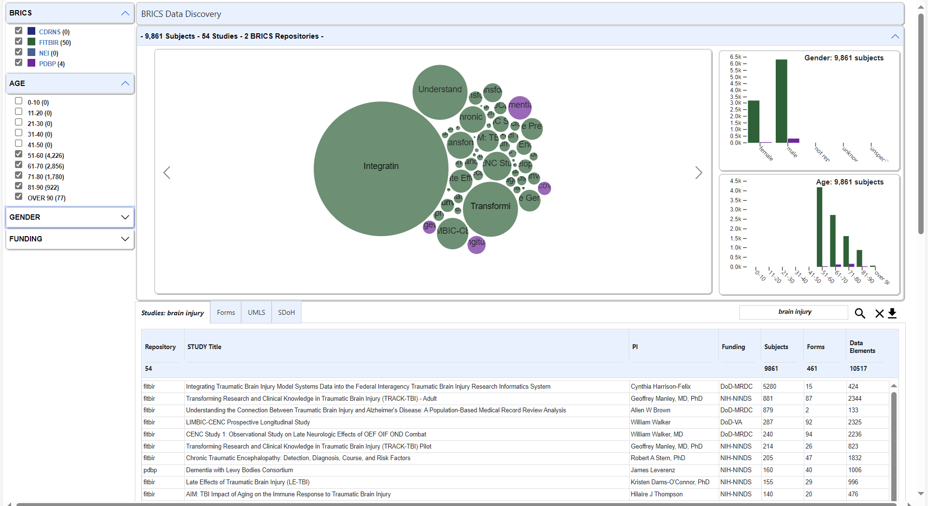
BRICS Data Discovery
https://brics.cit.nih.gov/visualization
Keyword Search: brain injury & Age Filter (50+)
9,861 Subjects – 54 Studies – 2 Repositories

Slide 17
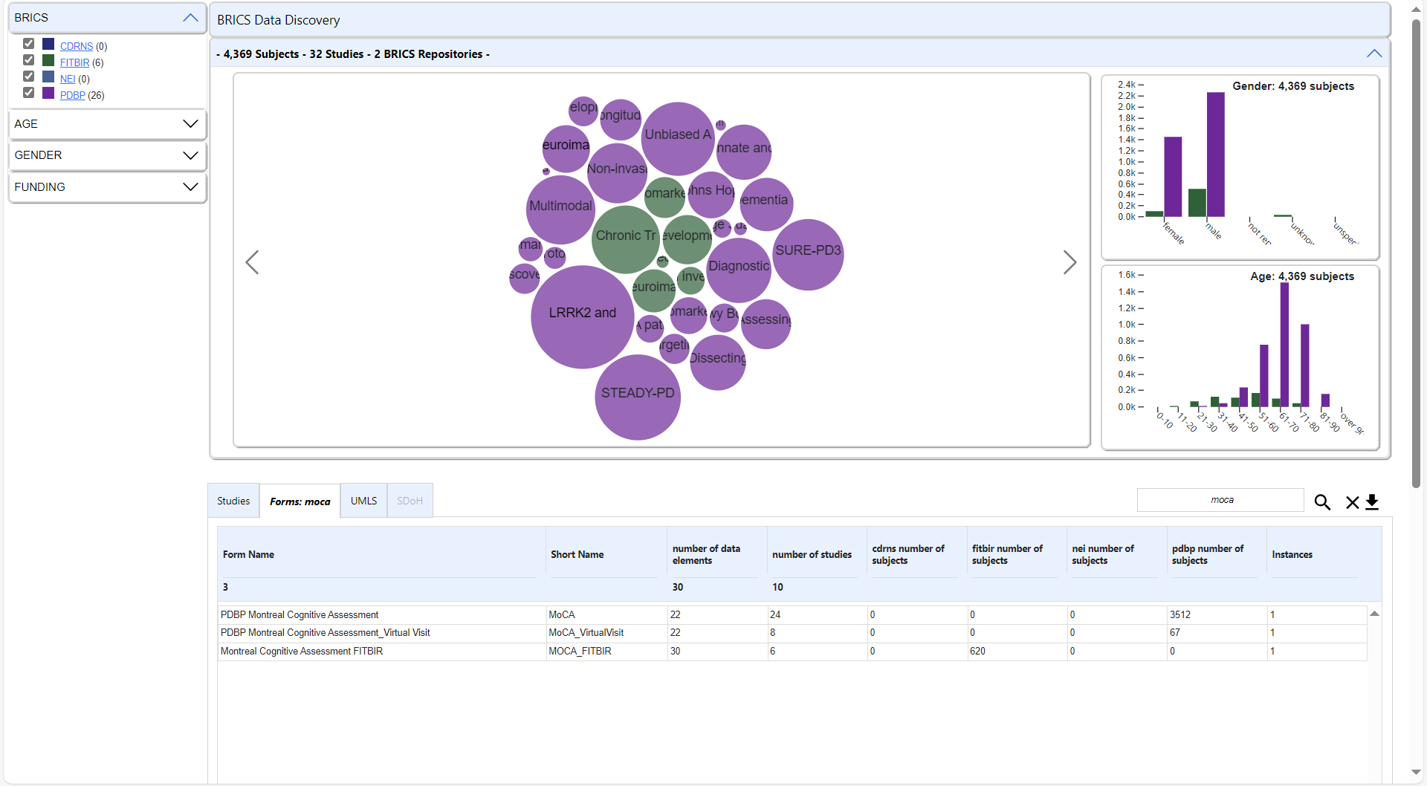
BRICS Data Discovery
https://brics.cit.nih.gov/visualization
Cohort Discovery: Form Structure: MoCA
4,369 Subjects – 32 Studies – 2 Repositories

Slide 18
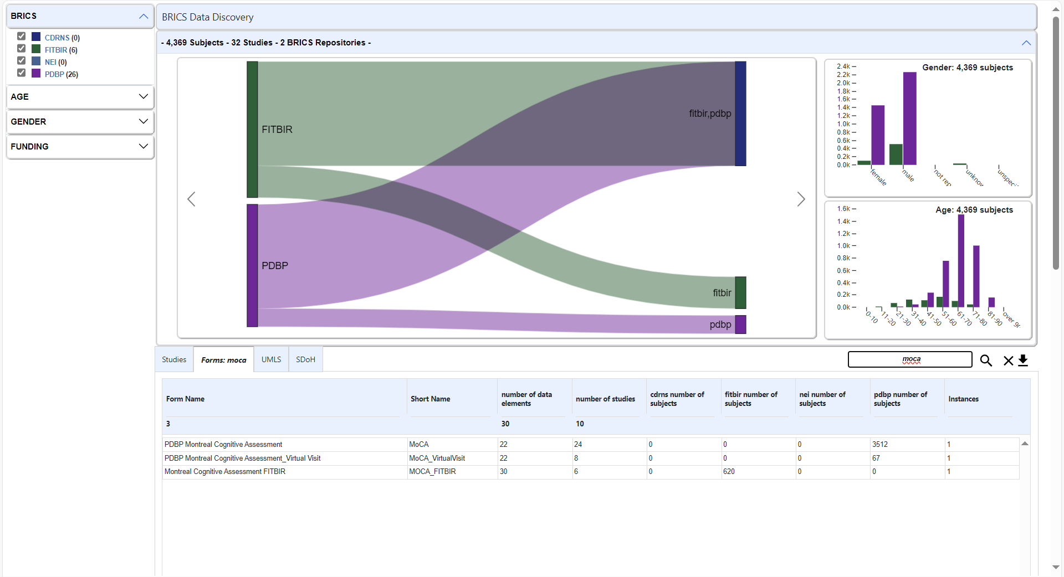
BRICS Data Discovery
https://brics.cit.nih.gov/visualization
Data Element Commonality: Form Structure: MoCA
3 form structures – 23 shared CDEs

Slide 19
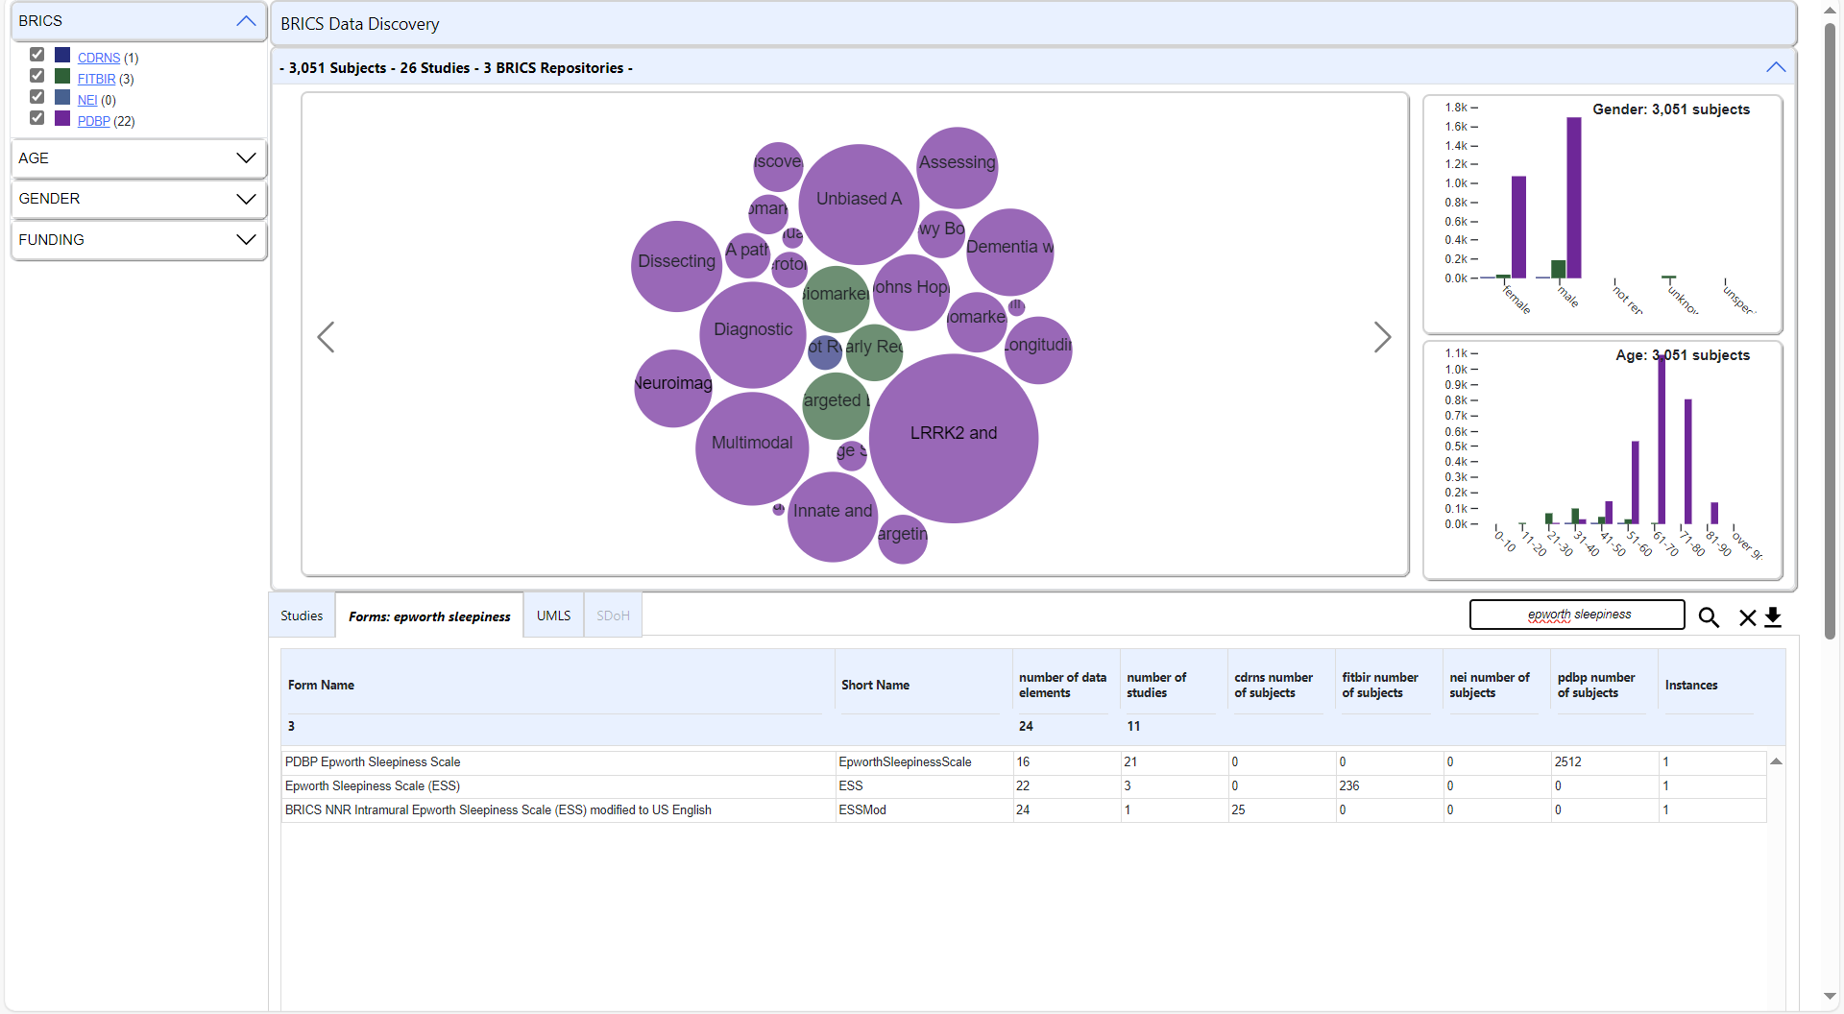
BRICS Data Discovery
https://brics.cit.nih.gov/visualization
Cohort Discovery: Form Structure: Epworth Sleepiness
3,051 Subjects – 26 Studies – 3 Repositories

Slide 20
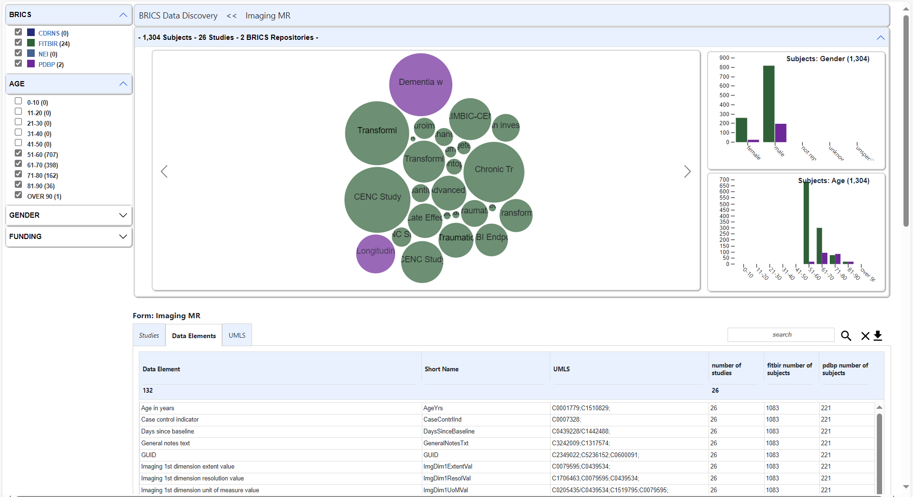
BRICS Data Discovery
https://brics.cit.nih.gov/visualization
Dive Deeper: Imaging MR: Data Elements
132 Data Elements – 1,304 Subjects – 26 Studies – 2 Repositories

Slide 21
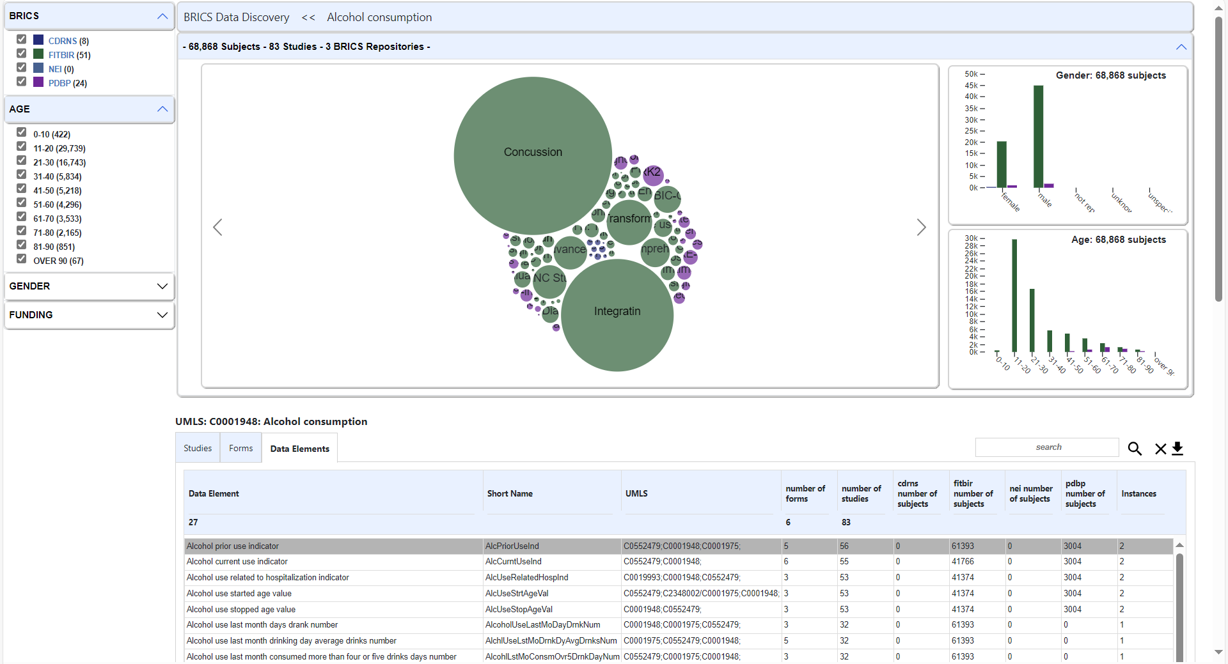
BRICS Data Discovery
https://brics.cit.nih.gov/visualization
Dive Deeper: UMLS CUI: C0001948 Alcohol Consumption
27 Data Elements – 68,868 Subjects – 83 Studies – 3 Repositories

Slide 22
BRICS Data Discovery
https://brics.cit.nih.gov/visualization
Ongoing & Future Research
Additional Study Filters
Data type: Clinical, Genomic, Imaging
Recruitment status: Active, Recruiting, Completed
Study Type: Clinical Trial, Observational, etc.
Advanced Search
DTI Imaging AND GCS Scores after baseline
Select & Explore Multiple Studies of Interest
Large Language Models
Find related form structures and data elements
Summarize similarities and differences between studies
Assist in discovering related areas of research.

Slide 23
BRICS
Data Discovery
Demo

Slide 24
BRICS Data Discovery
https://brics.cit.nih.gov/visualization
What Role can UMLS Concepts Play in Data Discovery?
Unified Medical Language System (UMLS)
Concept Unique Identifier (CUIs)
Link Common Data Elements (CDEs)
Different Data Elements with similar question text but different permissible values
Data Elements from the same form structure
Glasgow Coma Scale: C0017594
Data Elements from the same population
Pediatric: C1521725
Link Form Structures
Finding all form structures that capture the same concept
Fatigue: C0015672

Slide 25
BRICS Data Discovery
https://brics.cit.nih.gov/visualization
What Role can UMLS Concepts Play in Data Discovery?
 | CDRNS | FITBIR | NEI | NIA | PDBP
CDEs | 569 | 23,814 | 38 | 167 | 9,365
w/CUIs | 569 | 1343 | 38 | 167 | 495

Slide 26
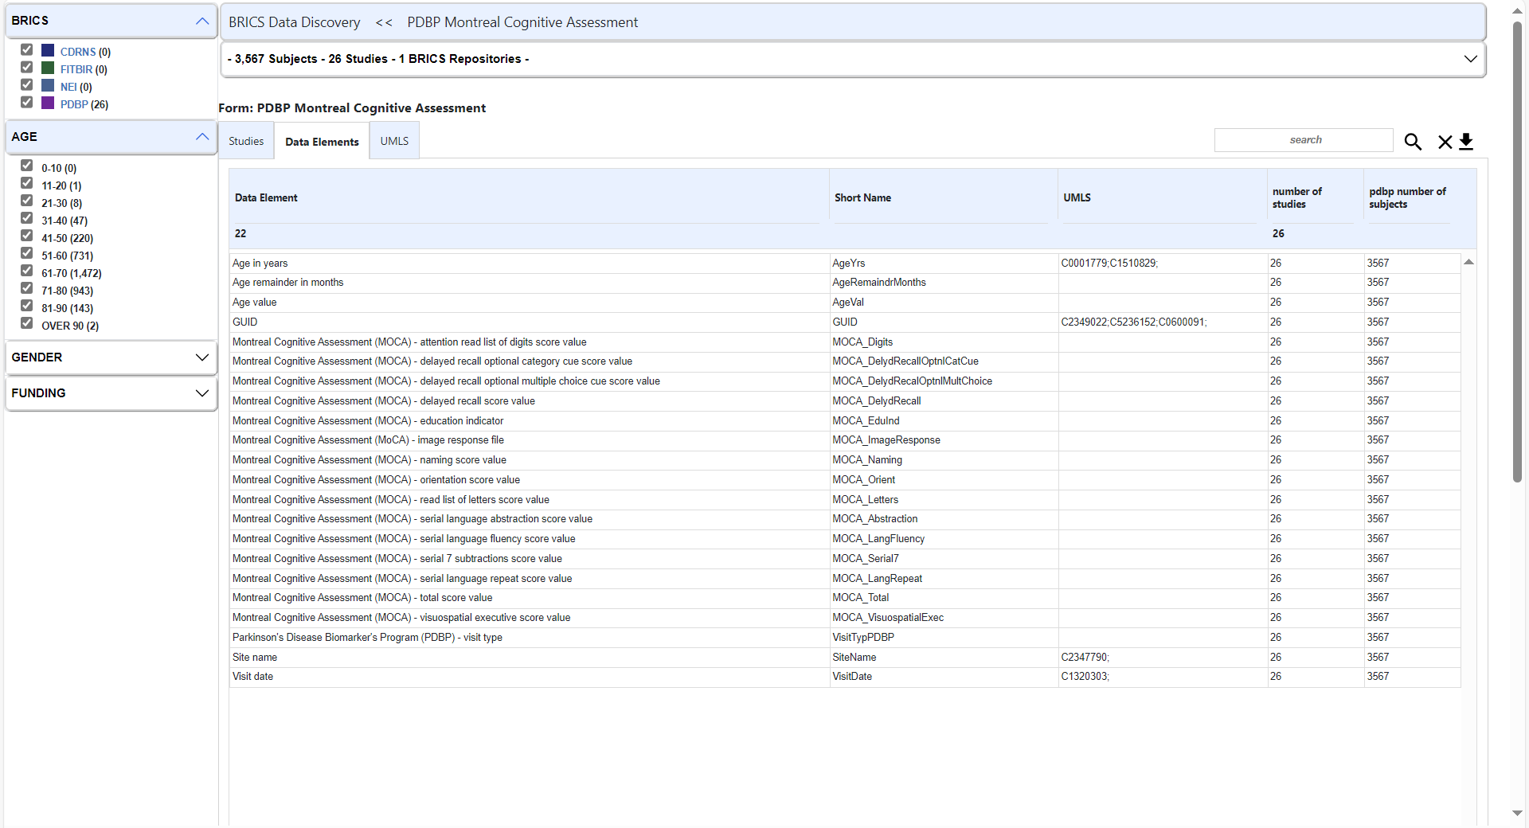
BRICS Data Discovery
https://brics.cit.nih.gov/visualization
Form Structure: PDBP Montreal Cognitive Assessment
4 CUIs – 22 Data Elements – 3,567 Subjects – 26 Studies – 1 Repository

Slide 27
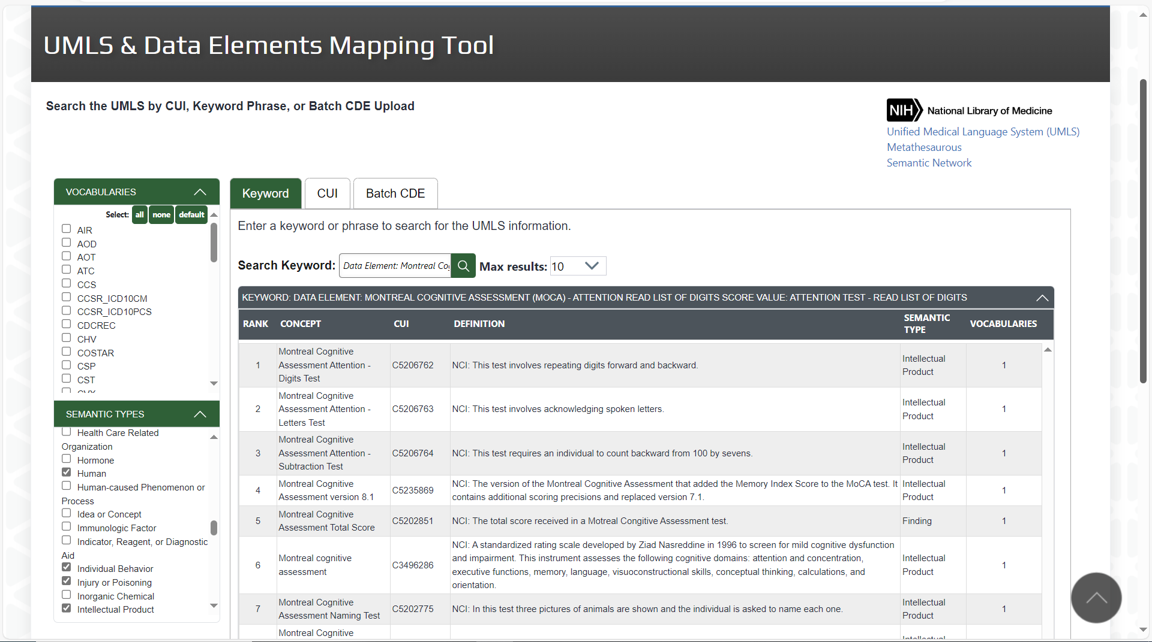
BRICS Data Discovery
https://brics.cit.nih.gov/intro

Slide 28
UMLS & CDE Mapping
Demo

Slide 29
BRICS Data Discovery
https://brics.cit.nih.gov/visualization
Exploration doesn’t end here…
UMLS Semantic Network Visualization
127 Semantic Types
Amphibian, Anatomical Structure, Organism, Sign or Symptom, Virus, …
125 Hierarchal Relationships
Activity -> Behavior -> Social behavior
Pathologic Function -> Disease or Syndrome -> Mental or Behavioral Disfunction
54 Semantic Relationships
Affects, Measurement of, Produces, Treats, …

Slide 30
BRICS Data Discovery
https://brics.cit.nih.gov/visualization
BRICS CDEs within an
Interactive UMLS Semantic Network

Slide 31
BRICS Data Discovery
https://brics.cit.nih.gov/visualization
Where do BRICS CDEs appear in Semantic Network?
4 BRICS Repositories
75 Semantic Types
915 CUIs
1375 CDEs (more to come)
Data elements across BRICS sorted by UMLS Semantic Type

Slide 32
BRICS Data Discovery
https://brics.cit.nih.gov/visualization
Highlight: Clinical Attribute
27 Data Elements – 77,272 Subjects – 140 Studies – 3 Repositories

Slide 33
UMLS
Semantic Network
Demo

Slide 34
Discussion

Slide 35
Closing Remarks

